Slide 1
Phoenix Gamification Teacher Workshop
Mr. Walker and Mr. Brewer.

Slide 2
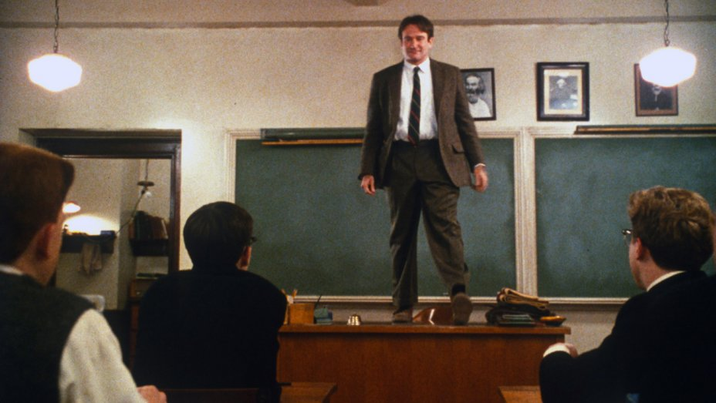
What are your goals as an educator?
Notes:
In short: Why Gamify?
By gamifying your classroom, what do you hope to accomplish?
Walker – I want to create a sense of belonging, and make learning as fun as possible.
Brewer – I want to meet students where they are at and start everything there.
Open it up and ask what the audience has in mind for goals? Seed: Increased engagement, students becoming risk-takers by feeling free to fail without grade consequences, sense of belonging, better relationships, less guesswork in behavioral expectations for students

Slide 3
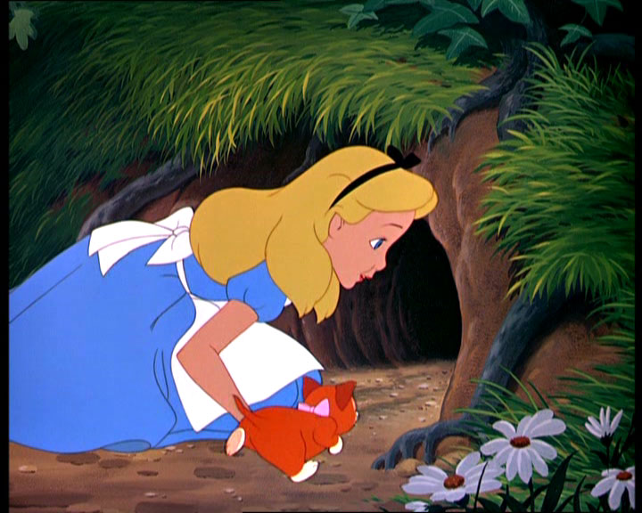
what Level of complexity are you interested in?
Notes:
What do we mean by complexity?
“If you were to gamify your classroom, how deep are your interested in gamifying”
Are you interested in behavior tracking, engagement building, or in turning your whole class into a game and acting as the GM/DM
For this workshop, we’ve identified three levels of interest and complexity for you to explore and consider for your own classroom.
If you are unsure of what you’d be comfortable implementing, choose randomly. All of the levels share similarities and there are interesting examples at each station.

Slide 4
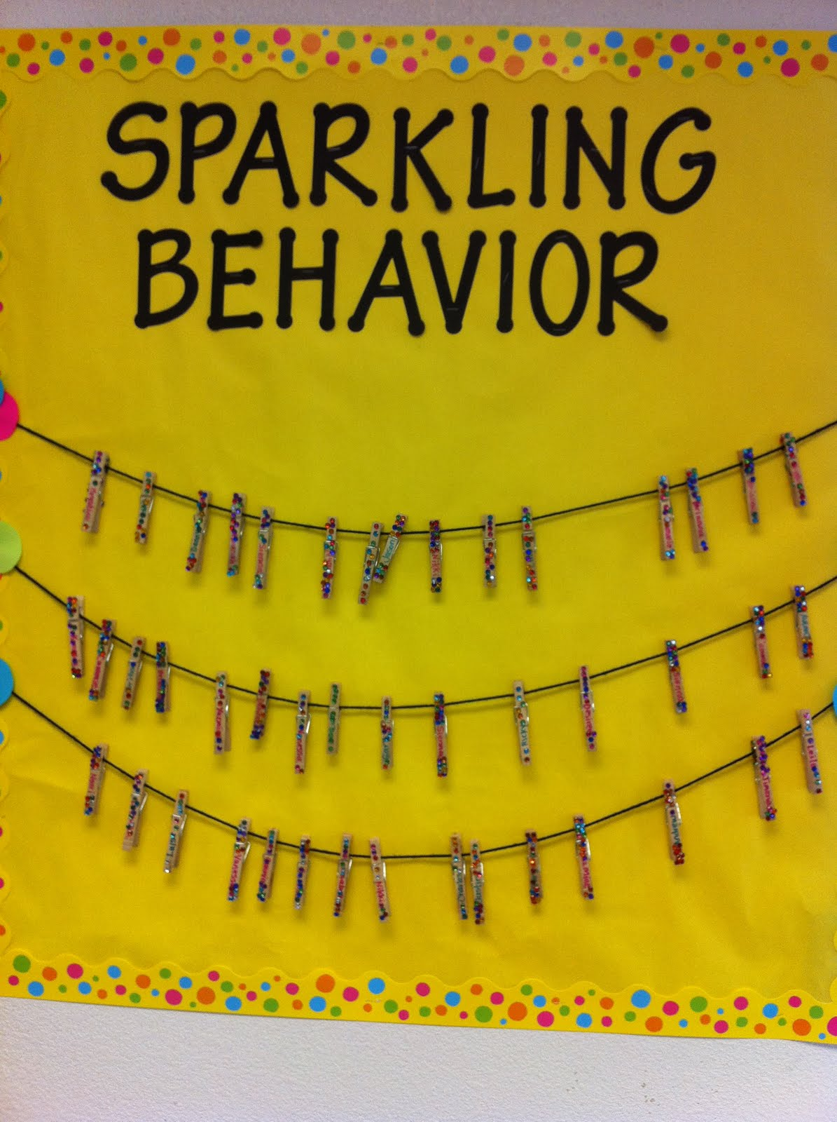
Level One – Behavior Tracking

Slide 5
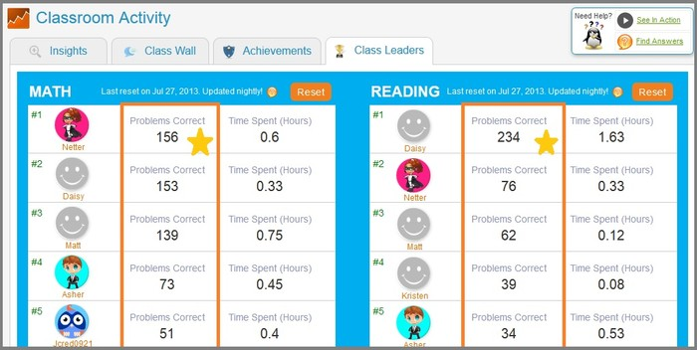
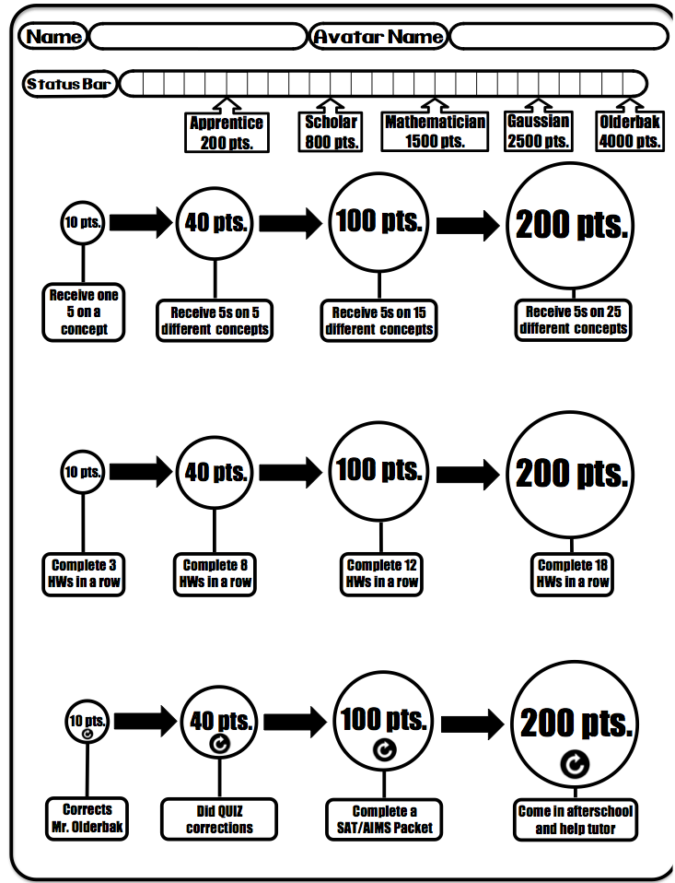
Level Two – Increasing Engagement
Notes:
Level 2
Soft skill and behavior management

Slide 6
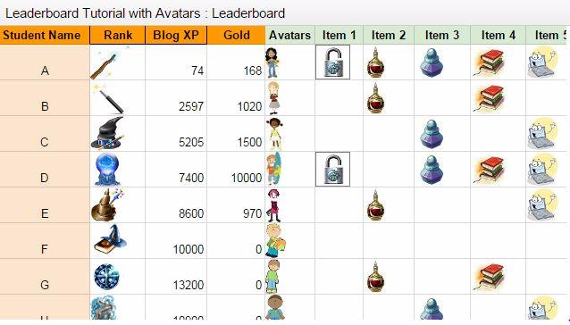
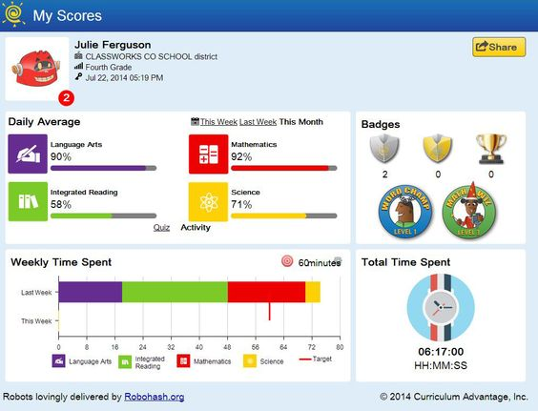
Level Three – Gamified Curriculum
Notes:
Level 3
Whole course is gamified

Slide 7
Three stations and workshop time
Notes:
One station for each level
We will be here until 5:00 PM
Feel free to come and go, grab a friend and bring them in to work on getting together a functioning classroom game!
Mr. Walker and Mr. Brewer will circulate and assist in discussion and production of your games.

Slide 8
Word of Caution
Word of caution
Avoid the negative
Avoid visible negative feedback, if you need to keep track of negative behavior, keep it out of your game
We already have structures in place for negatives

Slide 9
Call to action
Call to attempt LVL 1 at least and share this concept.
The goal is engagement and ownership, wherever it is applied
This concept is terrific for differentiated learning and increasing student sense of control

Slide 10
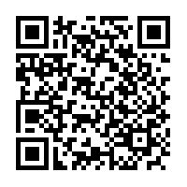
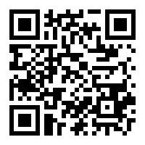
Our Contact Information
Mr. Walker
Jack.walker@Jefferson.kyschools.us
Mr. Brewer
john.brewer@Jefferson.kyschools.us
www.kingdomandkeys.com
Phoenix School Website

