Slide 1
Phoenix
ELCC 5 – Supporting Student Learning Project
John Brewer

Slide 2
Data Sources
Academic Data
MAP testing
ACT testing
K-Prep Scores (these were studied, but are considered to be not as directly influential as the ACT and MAP due to high student intake during grades 9-12)
Behavioral Data
DMC Data - Cascade Behavioral Data Management
Phoenix previous years
District Suspension data
School Climate Data
Tell Survey
JCPS Speaks Survey
JCPS School Profile (as posted in JCPS.org)

Slide 3
Data Summary – Academic Profile
Fig.1a
Phoenix has historical deficits in reading and math ability as determined by the JCPS School Report Card:
ACT scores 2014-present
English Benchmark 18 – Average of 20% met since 2014*
Math Benchmark of 19 – Average of 9% met since 2014
Reading Benchmark of 20 – Average of 25% met since 2014
These scores are over-represented in the following populations
GAP students - Average less than 10% benchmark in all areas
Free and Reduced Lunch Students - Average less than 10% benchmark in all areas
MAP scores 2017-present
Average Reading score is below 200
Average Math score is also below 200
200 is a normal score for a student between the fifth and sixth grade.
*Information in the graph to the left does not include students who have transferred within the 100 day window. Information above includes these students.
14-15 District
15-16 District
16-17 District

Slide 4
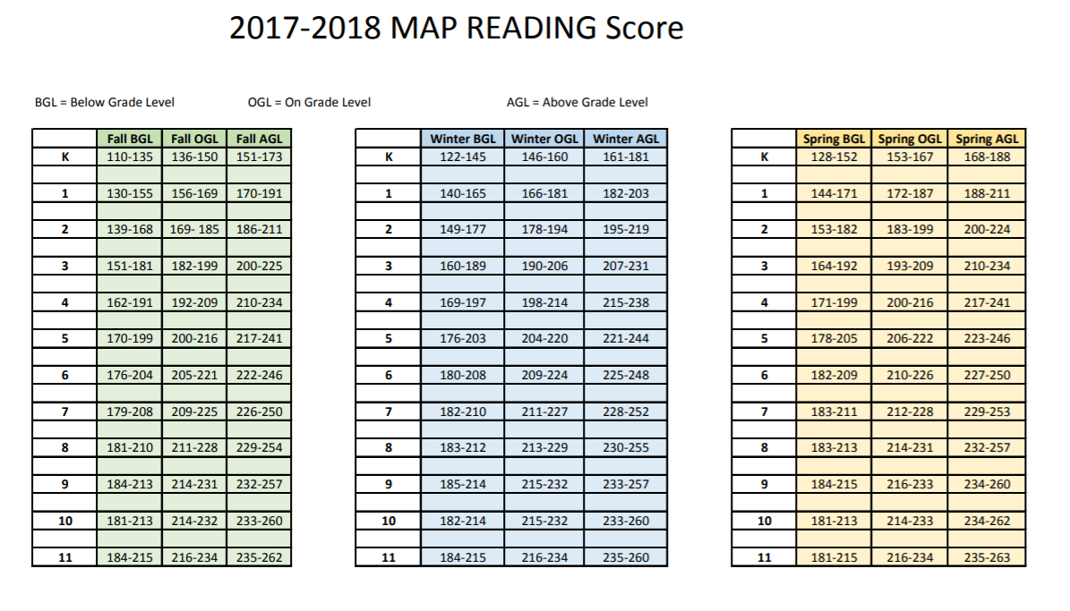
Fig.1b
Phoenix HS students have scored within this area on the MAP since 2017 (most current data)

Slide 5
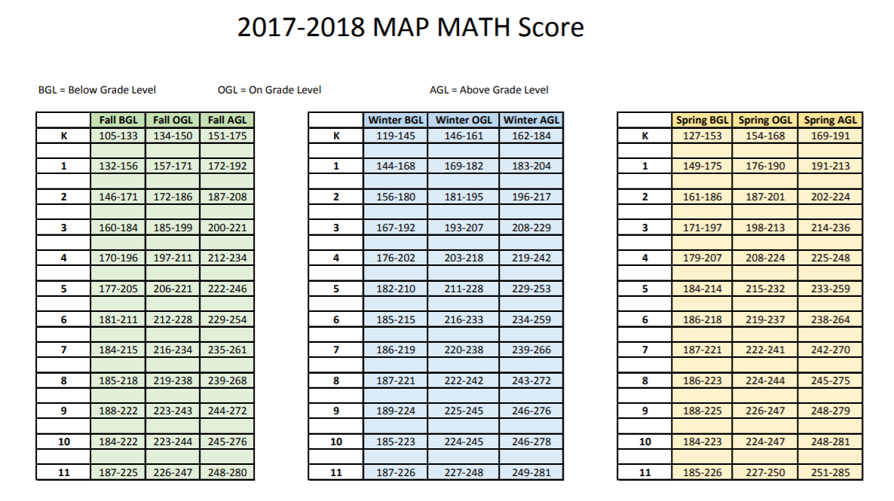
Fig.2
Phoenix HS students have scored within this area on the MAP since 2017 (most current data)

Slide 6
Data Summary – Behavioral Profile
Discussion of DMC behavioral data:
The most common referable behavior (according to the JCPS DMC behavioral data website) is “Failure to Respond to Questions or Requests.”
The most common behavioral resolution for ALL behavioral referrals is “Student Conference” which is a conversation and return to class. This reflects the Restorative Practice methodology that Phoenix applies to behavioral issues wherever possible.
Of students who have had behavior incidents during the past school year (2017-18):
31% are white males / 23% are white females
21% are black males / 18% are black females
63% are on free and reduced lunch
64% are non-ECE students
ECE population and manifestation explanation
Phoenix has an ECE population that is greater than 50% of the student body.
Phoenix is a Title-1 school and qualifies for full free and reduced lunch.
It is worth noting that Phoenix has a very high GAP and At-Risk percentage in its population, and inclusion of GAP and At-Risk students in behavioral data is not a particularly useful determiner when looking at Alt. Ed. Behavioral data.

Slide 7
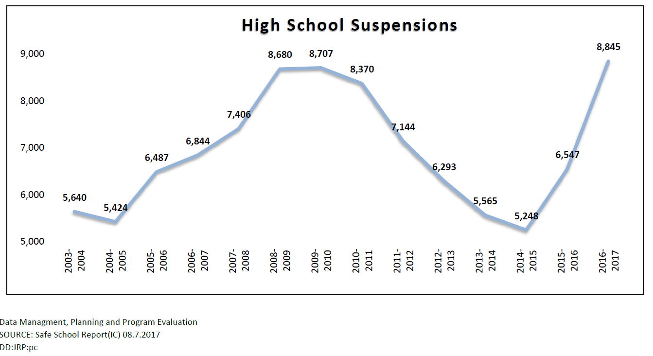
District Behavioral Trends of Note
Fig.3
Suspensions across the district have skyrocketed in the past four years. This can be attributed to many different factors:
Change in top level management
District audit increased fidelity of suspension for offenses that should have resulted in suspension
Shift away from Restorative Practices due to change in management
During this shift, the suspension rate at The Phoenix School has continued to drop.
15-16 School Year = 135
16-17 School Year = 111
17-18 School Year = 79
*DMC Data Table Used

Slide 8
Data Summary – Climate Profile
Fig.4
Equity Measure |  |  | School | District | State
Working Conditions* | Managing Student Conduct | Strongly Agree/Agree | 55.90% | 76.00% | 82.50%
 | Community Engagement and Support | Strongly Agree/Agree | 63.50% | 79.30% | 85.80%
 | School Leadership | Strongly Agree/Agree | 74.90% | 84.50% | 87.50%
According to JCPS internal data books for Equity Phoenix:
Has 31% turnover while the district has 18%
Has 26% new teacher training per year, while the district has 14%
The next page continues a look at the JCPS data book for Phoenix’s 2018 end of year data, and considers post-secondary outcomes as an extension of school climate, under the belief that school climate in an alternative school directly influences student outcomes after graduation.
This is a clear opportunity for program definition and clarification among the staff at Phoenix that responds to our mandate as an A-5 Alternative School within JCPS.
This clarity can help align teachers’ internalized sense of what makes a “good day” at Phoenix.
Recognizing and formalizing academic and behavioral win-states may help alleviate the turnover rate.

Slide 9
Data Summary – Climate Profile – Outcomes for Student Graduates
Fig.5
By Transition to Adult Life After Graduation | School |  | District |  | State
 | Total | Percentage | Total | Percentage | Total | Percentage
College (In State and Out of State) | 26 | 42.60% | 4,166 | 66.30% | 24,357 | 55.20%
- students indicated as attending college
College (In State only) | 24 | 39.30% | 3,543 | 56.40% | 21,845 | 49.50%
- students indicated as attending college
College (Out of State only) | 2 | 3.30% | 623 | 9.90% | 2,512 | 5.70%
- students indicated as attending college
Work and Part-Time College | 1 | 1.60% | 62 | 1.00% | 2,892 | 6.60%
- students working and attending college part-time
Vocational/Technical Training | 1 | 1.60% | 51 | 0.80% | 2,352 | 5.30%
- students receiving vocational/technical training
Military | 7 | 11.50% | 356 | 5.70% | 1,404 | 3.20%
- students indicated as in military
Working | 20 | 32.80% | 1,045 | 16.60% | 9,807 | 22.20%
- students indicated as in working
Unknown | 6 | 9.80% | 603 | 9.60% | 3,285 | 7.50%
- students not indicated with another status

Slide 10
Data Summary – Climate Profile – Teacher PD Need
Fig. 6/7
Teachers reported a greater need to meet “diverse student learning needs” at Phoenix during the Tell Survey.
Teachers also reported that they would like greater input into the nature of in-service learning programs.

Slide 11
School Profile: Issues Identified
Phoenix Profile, as told by data
Academic Profile
Students at Phoenix struggle with the foundational skills that will allow them to succeed. Students struggle with literacy and numeracy for a variety of reasons. More than half the student population has specific IEP goals in literacy or numeracy, which reflects this deficit.
Behavioral Profile
Students at Phoenix struggle with code-switching. Students have left their reside school for a variety of reasons, but many include failure to code-switch to academic language and relationship norms. This is exemplified in the behavioral data by a high number of profanity, failure to comply, and otherwise code-switching related offenses.
Climate Profile
Phoenix has a very high turnover rate. This is a problem that the other similarly mandated A-5 program Liberty High School, also has to wrestle with. It is difficult to keep teachers in programs with lower academic outcomes and higher behavioral needs. For students, however, the climate has produced a higher likelihood of employment post-secondary school, which is a huge success for programs like Phoenix.

Slide 12
School Profile: Takeaways
Profile Takeaways:
To optimize learning, academic deficits should always be taken into account, and behavioral needs should be framed in the language of code-switching, which appears to be the primary behavioral antecedent.
Specifically for ECE students, this means using a reliable and clear reporting process to determine when students are meeting their goals.
For GAP students, this requires a planned structural response to the diversity of student needs and goals.
The Principal of the school described by this data must know the two goals of academic growth and behavioral assistance well.
Assistant Principals must recognize code-switching as the primary producer of negative outcomes behaviorally.
Teacher department heads must recognize multiple “win-states,” for their departments, academic and behavioral successes may be mutually exclusive at times, but should both remain primary targets of interventions.
The social justice impact of responding to this profile is to more equitably serve GAP and ECE students, who require the greater specificity of intervention that Alternative Education provides.
All data has been disaggregated to protect the identity of students.

Slide 13
Three Issues as determined by Data Triangulation
Students need extended time for literacy and Numeracy
Recommendation: ESS (Extended School Services)
Teachers need cohesive definition of program goals, philosophy, and best practices for student population (GAP and ECE).
Recommendation: Book Study
Students need school structures that build emotional, academic, and career skills.
Recommendation: Tiered Portfolio Implementation

Slide 14
Three Specific Recommendations
ESS (Extended School Services)
Offering extended school services (ESS) to fill in reading and math gaps.
Book Study (Culturally Responsive Teaching & The Brain)
Author: Zaretta Hammond, 2015
Alignment of program language
Contains many strong research-based defenses of internalized Alternative School methods and interactions.
Tiered Portfolio Implementation (Project-Based Learning, Portfolio Defenses)
8th Grade – Personal Narrative
10th Grade – Personal Narrative and Academic
12th Grade – Personal Narrative and Career / Academic Focus

Slide 15
Three Specific Recommendations ESS Reasoning
ESS (Extended School Services)
Reason for need:
Historical deficits in reading and math ability as determined by:
ACT scores 2014-present
MAP scores 2014-present
K-Prep scores (ongoing)
Research Support:
Pittman, K. J., Irby, M., Yohalem, N., & Wilson-Ahlstrom, A. (2004). Blurring the lines for learning: The role of out-of-school programs as complements to formal learning. New Directions for Youth Development, 2004(101), 19–41. Retrieved from http://proxyse.uits.iu.edu/login?url=https://search.ebscohost.com/login.aspx?direct=true&db=aph&AN=12762576&site=ehost-live
This paper describes the best practices for linking ESS to in-school successes for students, academically and behaviorally, as well as how to frame the planning for an ESS to best produce academic growth results.

Slide 16
Three Specific Recommendations Book Study Reasoning
Book Study (Culturally Responsive Teaching & The Brain)
Reason for need:
Tell survey shows Phoenix staff would like PD that emphasizes the diversity of student needs and methods to reach those diverse needs.
Staff can benefit from alignment of language and external validation of best practices in an Alternative Setting with diverse learners.
School Climate shows students recognize that staff value their needs (Tell Survey) and this is a foundation that teachers can build on if they consolidate their language and defense of best practices at Phoenix using a common text.
Tell survey shows Phoenix staff would like input on in-service day PD’s
Research:
Keller, B. (2008). “Book Study” Helps Teachers Hone Skills. Education Week, 27(38), 1–15. Retrieved from http://proxyse.uits.iu.edu/login?url=https://search.ebscohost.com/login.aspx?direct=true&db=a ph&AN=32454722&site=ehost-live
This article discusses the positive team building aspects of doing a book study, as well as the usefulness of reading current YA literature to build camaraderie with students. The first aspect of the study is a greater defense of the Book study that I am proposing.

Slide 17
Three Specific Recommendations Tiered Portfolio Reasoning
Tiered Portfolio Implementation (Project-Based Learning, Portfolio Defenses)
Reason for need:
8th Grade – Low K-Prep scores indicate need for reading and writing and this project facilitates both
10th Grade – Low ACT scores indicate need for academically framed lessons in 9/10 grade and a portfolio defense aligned to ELA standards in Speech, Writing, and Research will facilitate these
12th Grade – Low retention in four year universities and high rate of student joblessness (anecdotal) requires emphasis on career skills, also focus on new JCPS backpack with research and reasoning supports this
Research:
Juniewicz, K. (2003). Student Portfolios with a Purpose. Clearing House, 77(2), 73–77. Retrieved from http://proxyse.uits.iu.edu/login?url=https://search.ebscohost.com/login.aspx?direct=true&db=a ph&AN=12701628&site=ehost-live
This article defends portfolios as a method of determining student cognition during tasks by marking artifacts of their path towards understanding, specifically within an art course.

Slide 18
Sources
Tell Survey - Phoenix
https://tellkentucky.org/results/report/548/167356
Tell Survey Liberty
https://tellkentucky.org/results/report/548/167257
- DMC Behavior - Cascade
https://assessment.jefferson.kyschools.us/DMC/Behavior/Behavior \
JCPS A1 Program Data Books for comparative data
https://www.jefferson.kyschools.us/departments/data-management-research/data-books
– MAP data – access to previous years as well as this year
https://sso.mapnwea.org/auth/login?dest=https%3A%2F%2Fteach.mapnwea.org%2Fadmin%2F
KDE School report card data
http://applications.education.ky.gov/SRC/Profile.aspx
Includes:
Assessment Data – K-Prep, ACT, AP Tests
Learning Environment Data – Students, Teachers, Tech, Community, Safety, Programs, Equity
Finance
Delivery Targets
Specific Articles Cited:
Pittman, K. J., Irby, M., Yohalem, N., & Wilson-Ahlstrom, A. (2004). Blurring the lines for learning: The role of out-of-school programs as complements to formal learning. New Directions for Youth Development, 2004(101), 19–41. Retrieved from http://proxyse.uits.iu.edu/login?url=https://search.ebscohost.com/login.aspx?direct=true&db=aph&AN=12762576&site=ehost-live
Keller, B. (2008). “Book Study” Helps Teachers Hone Skills. Education Week, 27(38), 1–15. Retrieved from http://proxyse.uits.iu.edu/login?url=https://search.ebscohost.com/login.aspx?direct=true&db=aph&AN=32454722&site=ehost-live
Juniewicz, K. (2003). Student Portfolios with a Purpose. Clearing House, 77(2), 73–77. Retrieved from http://proxyse.uits.iu.edu/login?url=https://search.ebscohost.com/login.aspx?direct=true&db=aph&AN=12701628&site=ehost-live

Slide 19
Fig. Reference
Fig. 1a – JCPS School Report Card
Fig. 1b – MAP Data
Fig. 2 – MAP Data
Fig. 3 – Safe Schools Report (2017)
Fig. 4 - JCPS School Report Card - Equity
Fig. 5 - JCPS School Report Card - Program Goals
Fig. 6/7 – Tell Survey

