Slide 1
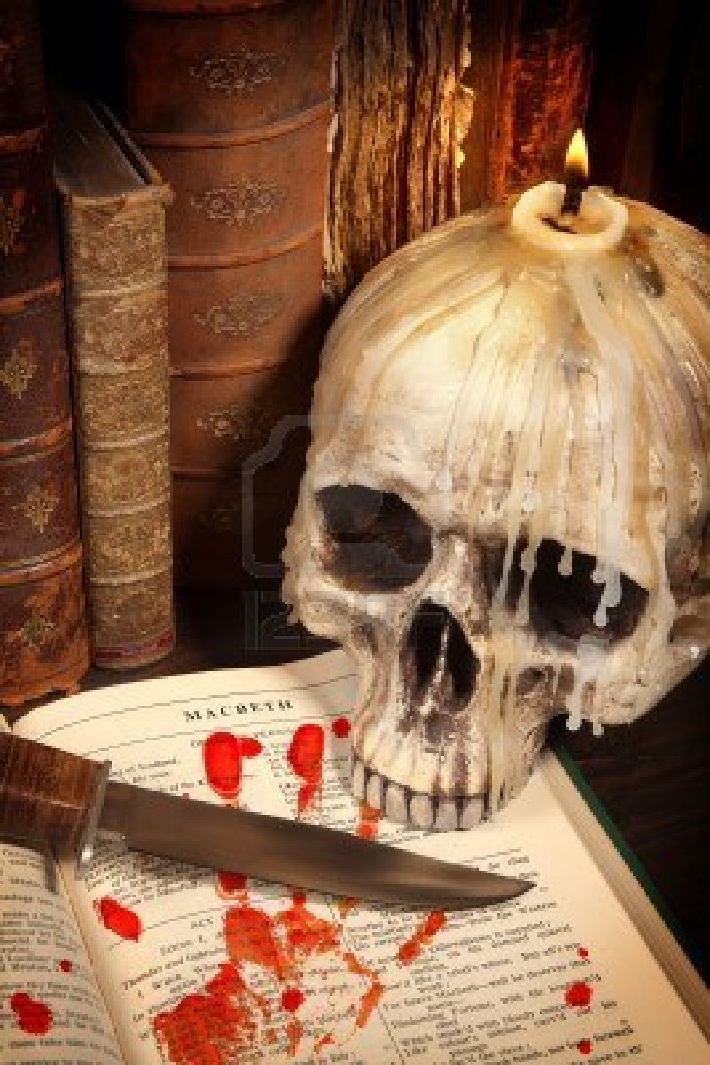
The Tragedy of Macbeth

Slide 2
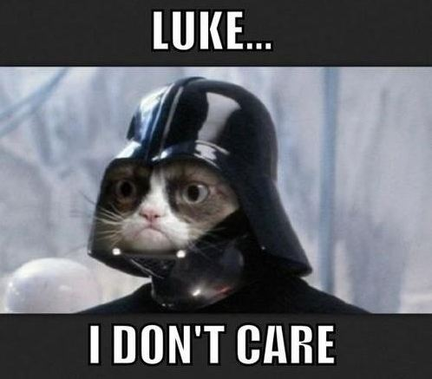
Act Three Scene One

Slide 3
Enter BANQUO
BANQUO
Thou hast it now: king, Cawdor, Glamis, all,
As the weird women promised, and I fear
Thou played’st most foully for ’t. Yet it was said
It should not stand in thy posterity,
But that myself should be the root and father
Of many kings. If there come truth from them—
As upon thee, Macbeth, their speeches shine—
Why, by the verities on thee made good,
May they not be my oracles as well,
And set me up in hope? But hush, no more.
BANQUO enters.
BANQUO
Now you have it all: you’re the king, the thane of Cawdor, and the thane of Glamis, just like the weird women promised you. And I suspect you cheated to win these titles. But it was also prophesied that the crown would not go to your descendants, and that my sons and grandsons would be kings instead. If the witches tell the truth—which they did about you—maybe what they said about me will come true too. But shhh! I’ll shut up now.

Slide 4
Sennet sounded. Enter MACBETH, as king, LADY MACBETH, as queen, LENNOX, ROSS,
LORDS,LADIES, and attendants
MACBETH
Here’s our chief guest.
LADY MACBETH
If he had been forgotten,
It had been as a gap in our great feast,
And all-thing unbecoming.
A trumpet plays. MACBETH enters dressed as king, and LADY MACBETH enters dressed as queen, together with LENNOX, ROSS,LORDS, LADIES, and their attendants
MACBETH
(indicating BANQUO) Here’s our most important guest.
LADY MACBETH
If we forgot him, our big celebration wouldn’t be complete, and that wouldn’t be any good.

Slide 5
MACBETH
Tonight we hold a solemn supper, sir,
And I’ll request your presence.
BANQUO
Let your highness
Command upon me, to the which my duties
Are with a most indissoluble tie
Forever knit.
MACBETH
Ride you this afternoon?
MACBETH
(to BANQUO) Tonight we’re having a ceremonial banquet, and I want you to be there.
BANQUO
Whatever your highness commands me to do, it is always my duty to do it.
MACBETH
Are you going riding this afternoon?

Slide 6
BANQUO
Ay, my good lord.
MACBETH
We should have else desired your good advice—
Which still hath been both grave and prosperous—
In this day’s council, but we’ll take tomorrow.
Is ’t far you ride?
BANQUO
As far, my lord, as will fill up the time
'Twixt this and supper. Go not my horse the better,
I must become a borrower of the night
For a dark hour or twain.
BANQUO
Yes, my good lord.
MACBETH
We would have liked to have heard your good advice, which has always been serious and helpful, at the council today, but we’ll wait until tomorrow. Are you riding far?
BANQUO
I’m going far enough that I’ll be riding from now until dinner. Unless my horse goes faster than expected, I will be back an hour or two after sunset.

Slide 7
MACBETH
Fail not our feast.
BANQUO
My lord, I will not.
MACBETH
We hear our bloody cousins are bestowed
In England and in Ireland, not confessing
Their cruel parricide, filling their hearers
With strange invention. But of that tomorrow,
When therewithal we shall have cause of state
Craving us jointly. Hie you to horse. Adieu,
Till your return at night. Goes Fleance with you?
MACBETH
Don’t miss our feast.
BANQUO
My lord, I won’t miss it.
MACBETH
We hear that the princes, those murderers, have hidden in England and Ireland. They haven’t confessed to cruelly murdering their own father, and they’ve been making up strange lies to tell their hosts. But we can talk more about that tomorrow, when we’ll discuss matters of state that concern us both. Hurry up and get to your horse. Good-bye, until you return tonight. Is Fleance going with you?

Slide 8
BANQUO
Ay, my good lord. Our time does call upon ’s.
MACBETH
I wish your horses swift and sure of foot,
And so I do commend you to their backs.
Farewell.
Exit BANQUO
MACBETH
Let every man be master of his time
Till seven at night. To make society
The sweeter welcome, we will keep ourself
Till suppertime alone. While then, God be with you!
BANQUO
Yes, my good lord. It’s time we hit the road.
MACBETH
I hope your horses are fast and surefooted. And with that, I send you to them. Farewell.
BANQUO exits.
MACBETH
Everybody may do as they please until seven o'clock tonight. In order to make your company even more enjoyable, I’m going to keep to myself until suppertime. Until then, God be with you!

Slide 9
Exeunt all except MACBETH and a SERVANT
MACBETH
Sirrah, a word with you. Attend those men
Our pleasure?
SERVANT
They are, my lord, without the palace gate.
MACBETH
Bring them before us.
Exit SERVANT
Everyone exits except MACBETH and a SERVANT
MACBETH
(to the SERVANT) You there, let me have a word with you. Are those men waiting for me?
SERVANT
They’re waiting outside the palace gate, my lord.
MACBETH
Bring them to me.
The SERVANT exits.

Slide 10
MACBETH
To be thus is nothing,
But to be safely thus. Our fears in Banquo
Stick deep, and in his royalty of nature
Reigns that which would be feared. 'Tis much he dares,
And to that dauntless temper of his mind
He hath a wisdom that doth guide his valor
To act in safety. There is none but he
Whose being I do fear, and under him
My genius is rebuked, as it is said
Mark Antony’s was by Caesar. He chid the sisters
When first they put the name of king upon me
And bade them speak to him. Then, prophetlike,
They hailed him father to a line of kings.
MACBETH
To be the king is nothing if I’m not safe as the king. I’m very afraid of Banquo. There’s something noble about him that makes me fear him. He’s willing to take risks, and his mind never stops working. He has the wisdom to act bravely but also safely. I’m not afraid of anyone but him. Around him, my guardian angel is frightened, just as Mark Antony’s angel supposedly feared Octavius Caesar. Banquo chided the witches when they first called me king, asking them to tell him his own future. Then, like prophets, they named him the father to a line of kings.

Slide 11
MACBETH
Upon my head they placed a fruitless crown
And put a barren scepter in my grip,
Thence to be wrenched with an unlineal hand,
No son of mine succeeding. If ’t be so,
For Banquo’s issue have I filed my mind;
For them the gracious Duncan have I murdered;
Put rancors in the vessel of my peace
Only for them; and mine eternal jewel
Given to the common enemy of man,
To make them kings, the seed of Banquo kings!
Rather than so, come fate into the list,
And champion me to th' utterance. Who’s there?
MACBETH
They gave me a crown and a scepter that I can’t pass on. Someone outside my family will take these things away from me, since no son of mine will take my place as king. If this is true, then I’ve tortured my conscience and murdered the gracious Duncan for Banquo’s sons. I’ve ruined my own peace for their benefit. I’ve handed over my everlasting soul to the devil so that they could be kings. Banquo’s sons, kings! Instead of watching that happen, I will challenge fate to battle and fight to the death. Who’s there!

Slide 12
Enter SERVANT and two MURDERERS
MACBETH
Now go to the door and stay there till we call.
Exit SERVANT
MACBETH
Was it not yesterday we spoke together?
FIRST MURDERER
It was, so please your highness.
The SERVANT comes back in with two MURDERERS
MACBETH
Now go to the door and stay there until I call for you.
The SERVANT exits.
MACBETH
Wasn’t it just yesterday that we spoke to each other?
FIRST MURDERER
It was yesterday, your highness.

Slide 13
MACBETH
Well then, now
Have you considered of my speeches? Know
That it was he, in the times past, which held you
So under fortune, which you thought had been
Our innocent self. This I made good to you
In our last conference, passed in probation with you,
How you were borne in hand, how crossed, the instruments,
Who wrought with them, and all things else that might
To half a soul and to a notion crazed
Say, “Thus did Banquo.”
MACBETH
Well, did you think about what I said? You should know that it was Banquo who made your lives hell for so long, which you always thought was my fault. But I was innocent. I showed you the proof at our last meeting. I explained how you were deceived, how you were thwarted, the things that were used against you, who was working against you, and a lot of other things that would convince even a half-wit or a crazy person to say, “Banquo did it!”

Slide 14
MACBETH
I did so, and went further, which is now
Our point of second meeting. Do you find
Your patience so predominant in your nature
That you can let this go? Are you so gospeled
To pray for this good man and for his issue,
Whose heavy hand hath bowed you to the grave
And beggared yours forever?
MACBETH
I did that and more, which brings me to the point of this second meeting. Are you so patient and forgiving that you’re going to let him off the hook? Are you so pious that you would pray for this man and his children, a man who has pushed you toward an early grave and put your family in poverty forever?

Slide 15
FIRST MURDERER
We are men, my liege.
MACBETH
Ay, in the catalogue ye go for men,
As hounds and greyhounds, mongrels, spaniels, curs,
Shoughs, water-rugs, and demi-wolves are clept
All by the name of dogs. The valued file
Distinguishes the swift, the slow, the subtle,
The housekeeper, the hunter, every one
According to the gift which bounteous nature
Hath in him closed, whereby he does receive
Particular addition, from the bill
That writes them all alike. And so of men.
FIRST MURDERER
We are men, my lord.
MACBETH
Yes, you’re part of the species called men. Just as hounds and greyhounds, mongrels, spaniels, mutts, shaggy lapdogs, swimming dogs, and wolf-dog crossbreeds are all dogs. But if you list the different kinds of dogs according to their qualities, you can distinguish which breeds are fast or slow, which ones are clever, which ones are watchdogs, and which ones hunters. You can classify each dog according to the natural gifts that separate it from all other dogs. It’s the same with men.

Slide 16
MACBETH
Now, if you have a station in the file,
Not i' th' worst rank of manhood, say ’t,
And I will put that business in your bosoms,
Whose execution takes your enemy off,
Grapples you to the heart and love of us,
Who wear our health but sickly in his life,
Which in his death were perfect.
MACBETH
Now, if you occupy some place in the list of men that isn’t down at the very bottom, tell me. Because if that’s the case, I will tell you a plan that will get rid of your enemy and bring you closer to me. As long as Banquo lives, I am sick. I’ll be healthy when he is dead.

Slide 17
SECOND MURDERER
I am one, my liege,
Whom the vile blows and buffets of the world
Have so incensed that I am reckless what
I do to spite the world.
FIRST MURDERER
And I another
So weary with disasters, tugged with fortune,
That I would set my life on any chance,
To mend it or be rid on ’t.
SECOND MURDERER
My lord, I’ve been so kicked around by the world, and I’m so angry, that I don’t even care what I do.
FIRST MURDERER
I’m the same. I’m so sick of bad luck and trouble that I’d risk my life on any bet, as long as it would either fix my life or end it once and for all.

Slide 18
MACBETH
Both of you
Know Banquo was your enemy.
BOTH MURDERERS
True, my lord.
MACBETH
So is he mine; and in such bloody distance
That every minute of his being thrusts
Against my near’st of life. And though I could
With barefaced power sweep him from my sight
And bid my will avouch it, yet I must not,
For certain friends that are both his and mine,
Whose loves I may not drop, but wail his fall
Who I myself struck down. And thence it is,
That I to your assistance do make love,
Masking the business from the common eye
For sundry weighty reasons.
MACBETH
You both know Banquo was your enemy.
BOTH MURDERERS
It’s true, my lord.
MACBETH
He’s my enemy too, and I hate him so much that every minute he’s alive it eats away at my heart. Since I’m king, I could simply use my power to get rid of him. But I can’t do that, because he and I have friends in common whom I need, so I have to be able to moan and cry over his death in public even though I’ll be the one who had him killed. That’s why I need your help right now. I have to hide my real plans from the public eye for many important reasons.

Slide 19
SECOND MURDERER
We shall, my lord,
Perform what you command us.
FIRST MURDERER
Though our lives—
MACBETH
Your spirits shine through you. Within this hour at most
I will advise you where to plant yourselves,
Acquaint you with the perfect spy o' th' time,
The moment on ’t; for ’t must be done tonight,
And something from the palace; always thought
That I require a clearness. And with him—
To leave no rubs nor botches in the work—
Fleance, his son, that keeps him company,
Whose absence is no less material to me
Than is his father’s, must embrace the fate
Of that dark hour. Resolve yourselves apart.
I’ll come to you anon.
SECOND MURDERER
We’ll do what you want us to, my lord.
FIRST MURDERER
Though our lives—
MACBETH
(interrupts him) I can see the determination in your eyes. Within the next hour I’ll tell you where to go and exactly when to strike. It must be done tonight, away from the palace. Always remember that I must be free from suspicion. For the plan to work perfectly, you must kill both Banquo and his son, Fleance, who keeps him company. Getting rid of Fleance is as important to me as knocking off Banquo. Each of you should make up your own mind about whether you’re going to do this. I’ll come to you soon.

Slide 20
BOTH MURDERERS
We are resolved, my lord.
MACBETH
I’ll call upon you straight. Abide within.
Exeunt MURDERERS
MACBETH
It is concluded. Banquo, thy soul’s flight,
If it find heaven, must find it out tonight.
Exit
BOTH MURDERERS
We have decided, my lord. We’re in.
MACBETH
I’ll call for you soon. Stay inside.
The MURDERERS exit.
MACBETH
The deal is closed. Banquo, if your soul is going to make it to heaven, tonight’s the night.
He exits.

Slide 21
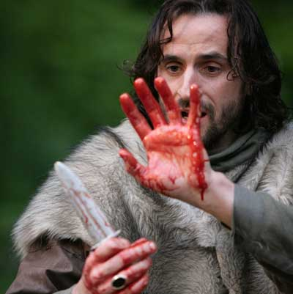
Act Three Scene Two

Slide 22
Enter LADY MACBETH and a SERVANT
LADY MACBETH
Is Banquo gone from court?
SERVANT
Ay, madam, but returns again tonight.
LADY MACBETH
Say to the king I would attend his leisure
For a few words.
LADY MACBETH and a SERVANT enter.
LADY MACBETH
Has Banquo left the court?
SERVANT
Yes, madam, but he’ll be back tonight.
LADY MACBETH
Go tell the king I want to talk to him for a few minutes.

Slide 23
SERVANT
Madam, I will.
Exit SERVANT
LADY MACBETH
Naught’s had, all’s spent,
Where our desire is got without content.
'Tis safer to be that which we destroy
Than by destruction dwell in doubtful joy.
SERVANT
No problem, madam.
The SERVANT exits.
LADY MACBETH
If you get what you want and you’re still not happy, you’ve spent everything and gained nothing. It’s better to be the person who gets murdered than to be the killer and be tormented with anxiety.

Slide 24
Enter MACBETH
LADY MACBETH
How now, my lord! Why do you keep alone,
Of sorriest fancies your companions making,
Using those thoughts which should indeed have died
With them they think on? Things without all remedy
Should be without regard. What’s done is done.
MACBETH enters.
LADY MACBETH
What’s going on, my lord? Why are you keeping to yourself, with only your sad thoughts to keep you company? Those thoughts should have died when you killed the men you’re thinking about. If you can’t fix it, you shouldn’t give it a second thought. What’s done is done.

Slide 25
MACBETH
We have scorched the snake, not killed it.
She’ll close and be herself whilst our poor malice
Remains in danger of her former tooth.
But let the frame of things disjoint, both the worlds suffer,
Ere we will eat our meal in fear, and sleep
In the affliction of these terrible dreams
That shake us nightly. Better be with the dead,
MACBETH
We have slashed the snake but not killed it. It will heal and be as good as new, and we’ll be threatened by its fangs once again. But the universe can fall apart, and heaven and earth crumble, before I’ll eat my meals in fear and spend my nights tossing and turning with these nightmares I’ve been having. I’d rather be dead than endure this endless mental torture and harrowing sleep deprivation.

Slide 26
MACBETH
Whom we, to gain our peace, have sent to peace,
Than on the torture of the mind to lie
In restless ecstasy. Duncan is in his grave.
After life’s fitful fever he sleeps well.
Treason has done his worst; nor steel nor poison,
Malice domestic, foreign levy, nothing
Can touch him further.
MACBETH
We killed those men and sent them to rest in peace so that we could gain our own peace. Duncan lies in his grave, through with life’s troubles, and he’s sleeping well. We have already done the worst we can do to him with our treason. After that, nothing can hurt him further—not weapons, poison, rebellion, invasion, or anything else.

Slide 27
LADY MACBETH
Come on, gentle my lord,
Sleek o'er your rugged looks. Be bright and jovial
Among your guests tonight.
MACBETH
So shall I, love,
And so, I pray, be you. Let your remembrance
Apply to Banquo; present him eminence,
Both with eye and tongue: unsafe the while that we
Must lave our honors in these flattering streams,
And make our faces vizards to our hearts,
Disguising what they are.
LADY MACBETH
Come on, relax, dear. Put on a happy face and look cheerful and agreeable for your guests tonight.
MACBETH
That’s exactly what I’ll do, my love, and I hope you’ll do the same. Give Banquo your special attention. Talk to him and look at him in a way that will make him feel important. We’re in a dangerous situation, where we have to flatter him and hide our true feelings.

Slide 28
LADY MACBETH
You must leave this.
MACBETH
Oh, full of scorpions is my mind, dear wife!
Thou know’st that Banquo, and his Fleance, lives.
LADY MACBETH
But in them nature’s copy’s not eternal.
LADY MACBETH
You have to stop talking like this.
MACBETH
Argh! I feel like my mind is full of scorpions, my dear wife. You know that Banquo and his son Fleance are still alive.
LADY MACBETH
But they can’t live forever.

Slide 29
MACBETH
There’s comfort yet; they are assailable.
Then be thou jocund. Ere the bat hath flown
His cloistered flight, ere to black Hecate’s summons
The shard-borne beetle with his drowsy hums
Hath rung night’s yawning peal, there shall be done
A deed of dreadful note.
LADY MACBETH
What’s to be done?
MACBETH
That’s comforting. They can be killed, it’s true. So be cheerful. Before the bat flies through the castle, and before the dung beetle makes his little humming noise to tell us it’s nighttime, a dreadful deed will be done.
LADY MACBETH
What are you going to do?

Slide 30
MACBETH
Be innocent of the knowledge, dearest chuck,
Till thou applaud the deed. Come, seeling night,
Scarf up the tender eye of pitiful day
And with thy bloody and invisible hand
Cancel and tear to pieces that great bond
Which keeps me pale. Light thickens, and the crow
Makes wing to th' rooky wood.
Good things of day begin to droop and drowse;
Whiles night’s black agents to their preys do rouse.
Thou marvel’st at my words: but hold thee still.
Things bad begun make strong themselves by ill.
So, prithee, go with me.
Exeunt
MACBETH
It’s better you don’t know about it until after it’s done, when you can applaud it. (to the night) Come, night, and blindfold the kindhearted day. Use your bloody and invisible hand to tear up Banquo’s lease on life, which keeps me in fear. (to himself) The sky’s getting dark, and the crow is returning home to the woods. The gentle creatures of the day are falling asleep, while night’s predators are waking up to look for their prey. (to LADY MACBETH) You seem surprised at my words, but don’t question me yet. Bad deeds force you to commit more bad deeds. So please, come with me.
They exit.

Slide 31
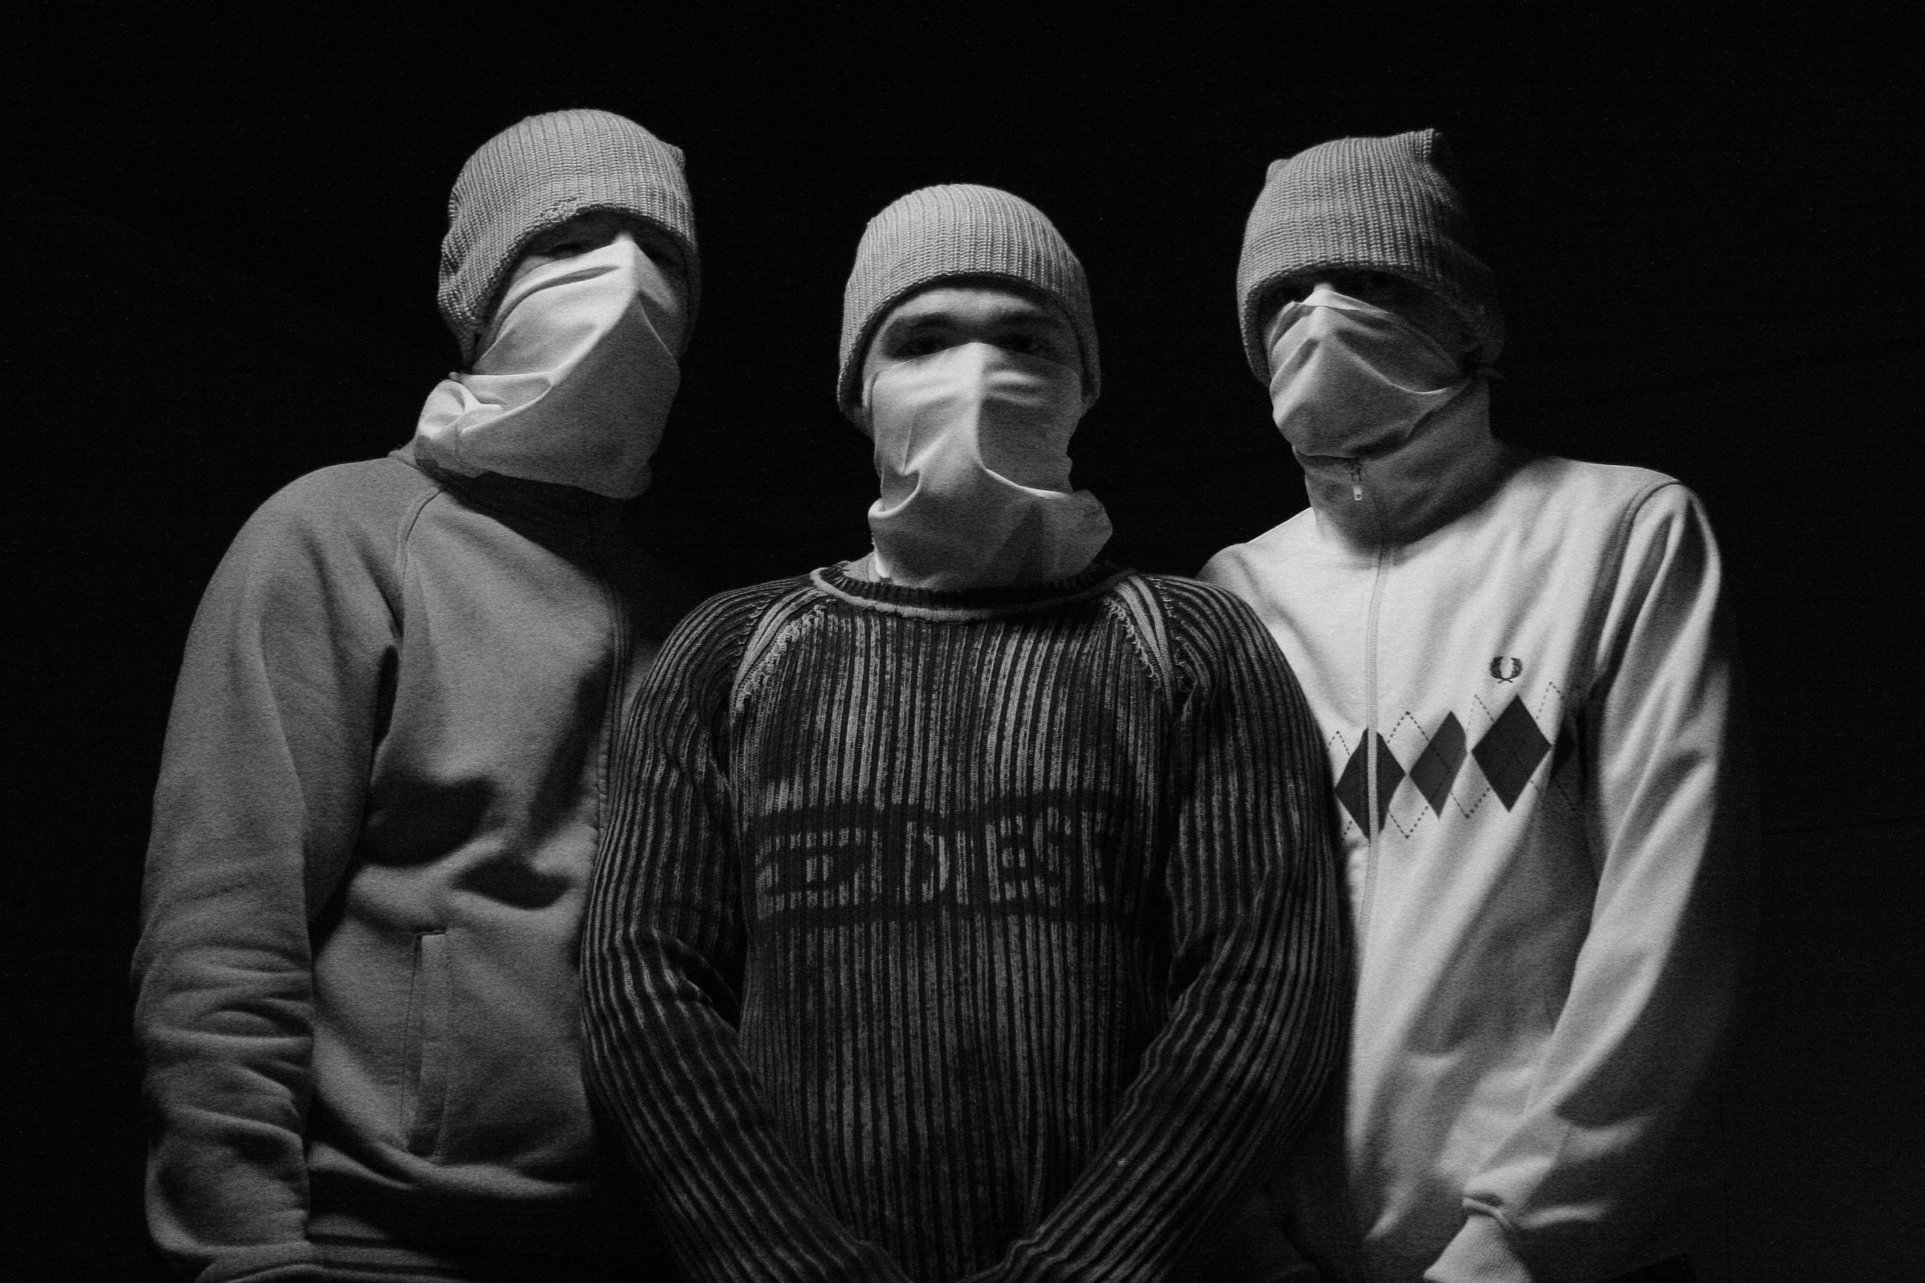
Act Three Scene Three

Slide 32
Enter three MURDERERS
FIRST MURDERER
But who did bid thee join with us?
THIRD MURDERER
Macbeth.
SECOND MURDERER
He needs not our mistrust, since he delivers
Our offices and what we have to do
To the direction just.
The two MURDERERS enter with a third MURDERER.
FIRST MURDERER
But who told you to come here and join us?
THIRD MURDERER
Macbeth.
SECOND MURDERER
We can trust this guy. He was given exactly the same orders we were.

Slide 33
FIRST MURDERER
Then stand with us.
The west yet glimmers with some streaks of day.
Now spurs the lated traveler apace
To gain the timely inn, and near approaches
The subject of our watch.
THIRD MURDERER
Hark, I hear horses.
BANQUO
(within) Give us a light there, ho!
SECOND MURDERER
Then ’tis he: the rest
That are within the note of expectation
Already are i' th' court.
FIRST MURDERER
Then stay with us. There’s still a bit of daylight in the sky. Now all the late travellers are hurrying to reach their inns. Banquo is almost here.
THIRD MURDERER
Listen! I hear horses.
BANQUO
(from offstage) Hey, give us some light here!
SECOND MURDERER
That must be him. The rest of the king’s guests are already inside.

Slide 34
FIRST MURDERER
His horses go about.
THIRD MURDERER
Almost a mile; but he does usually—
So all men do—from hence to the palace gate
Make it their walk.
Enter BANQUO and FLEANCE with a torch
FIRST MURDERER
You can hear his horses moving around as the servants take them to the stables.
THIRD MURDERER
It’s almost a mile to the palace gate, but Banquo, like everybody else, usually walks from here to the palace.
BANQUO and FLEANCE enter with a torch

Slide 35
SECOND MURDERER
A light, a light!
THIRD MURDERER
'Tis he.
FIRST MURDERER
Stand to ’t.
BANQUO
It will be rain tonight.
FIRST MURDERER
Let it come down.
SECOND MURDERER
Here comes a light! Here comes a light!
THIRD MURDERER
That’s him.
FIRST MURDERER
Prepare yourselves.
BANQUO
It will rain tonight.
FIRST MURDERER
Then let the rain come down.

Slide 36
The MURDERERS attack BANQUO
BANQUO
O treachery! Fly, good Fleance, fly, fly, fly!
Thou may ’st revenge —O slave!
BANQUO dies. Exit FLEANCE
THIRD MURDERER
Who did strike out the light?
The MURDERERS attack BANQUO.
BANQUO
Oh, this is treachery! Get out of here, good Fleance, run, run, run! Someday you can get revenge.—Oh, you bastard!
BANQUO dies. FLEANCE escapes.
THIRD MURDERER
Who put out the light?

Slide 37
FIRSTMURDERER
Was ’t not the way?
THIRD MURDERER
There’s but one down. The son is fled.
SECOND MURDERER
We have lost best half of our affair.
FIRST MURDERER
Well, let’s away and say how much is done.
Exeunt
FIRST MURDERER
Wasn’t that the best thing to do?
THIRD MURDERER
There’s only one body here. The son ran away.
SECOND MURDERER
We failed in half of our mission.
FIRST MURDERER
Well, let’s get out of here and tell Macbeth what we did accomplish.
They exit.

Slide 38
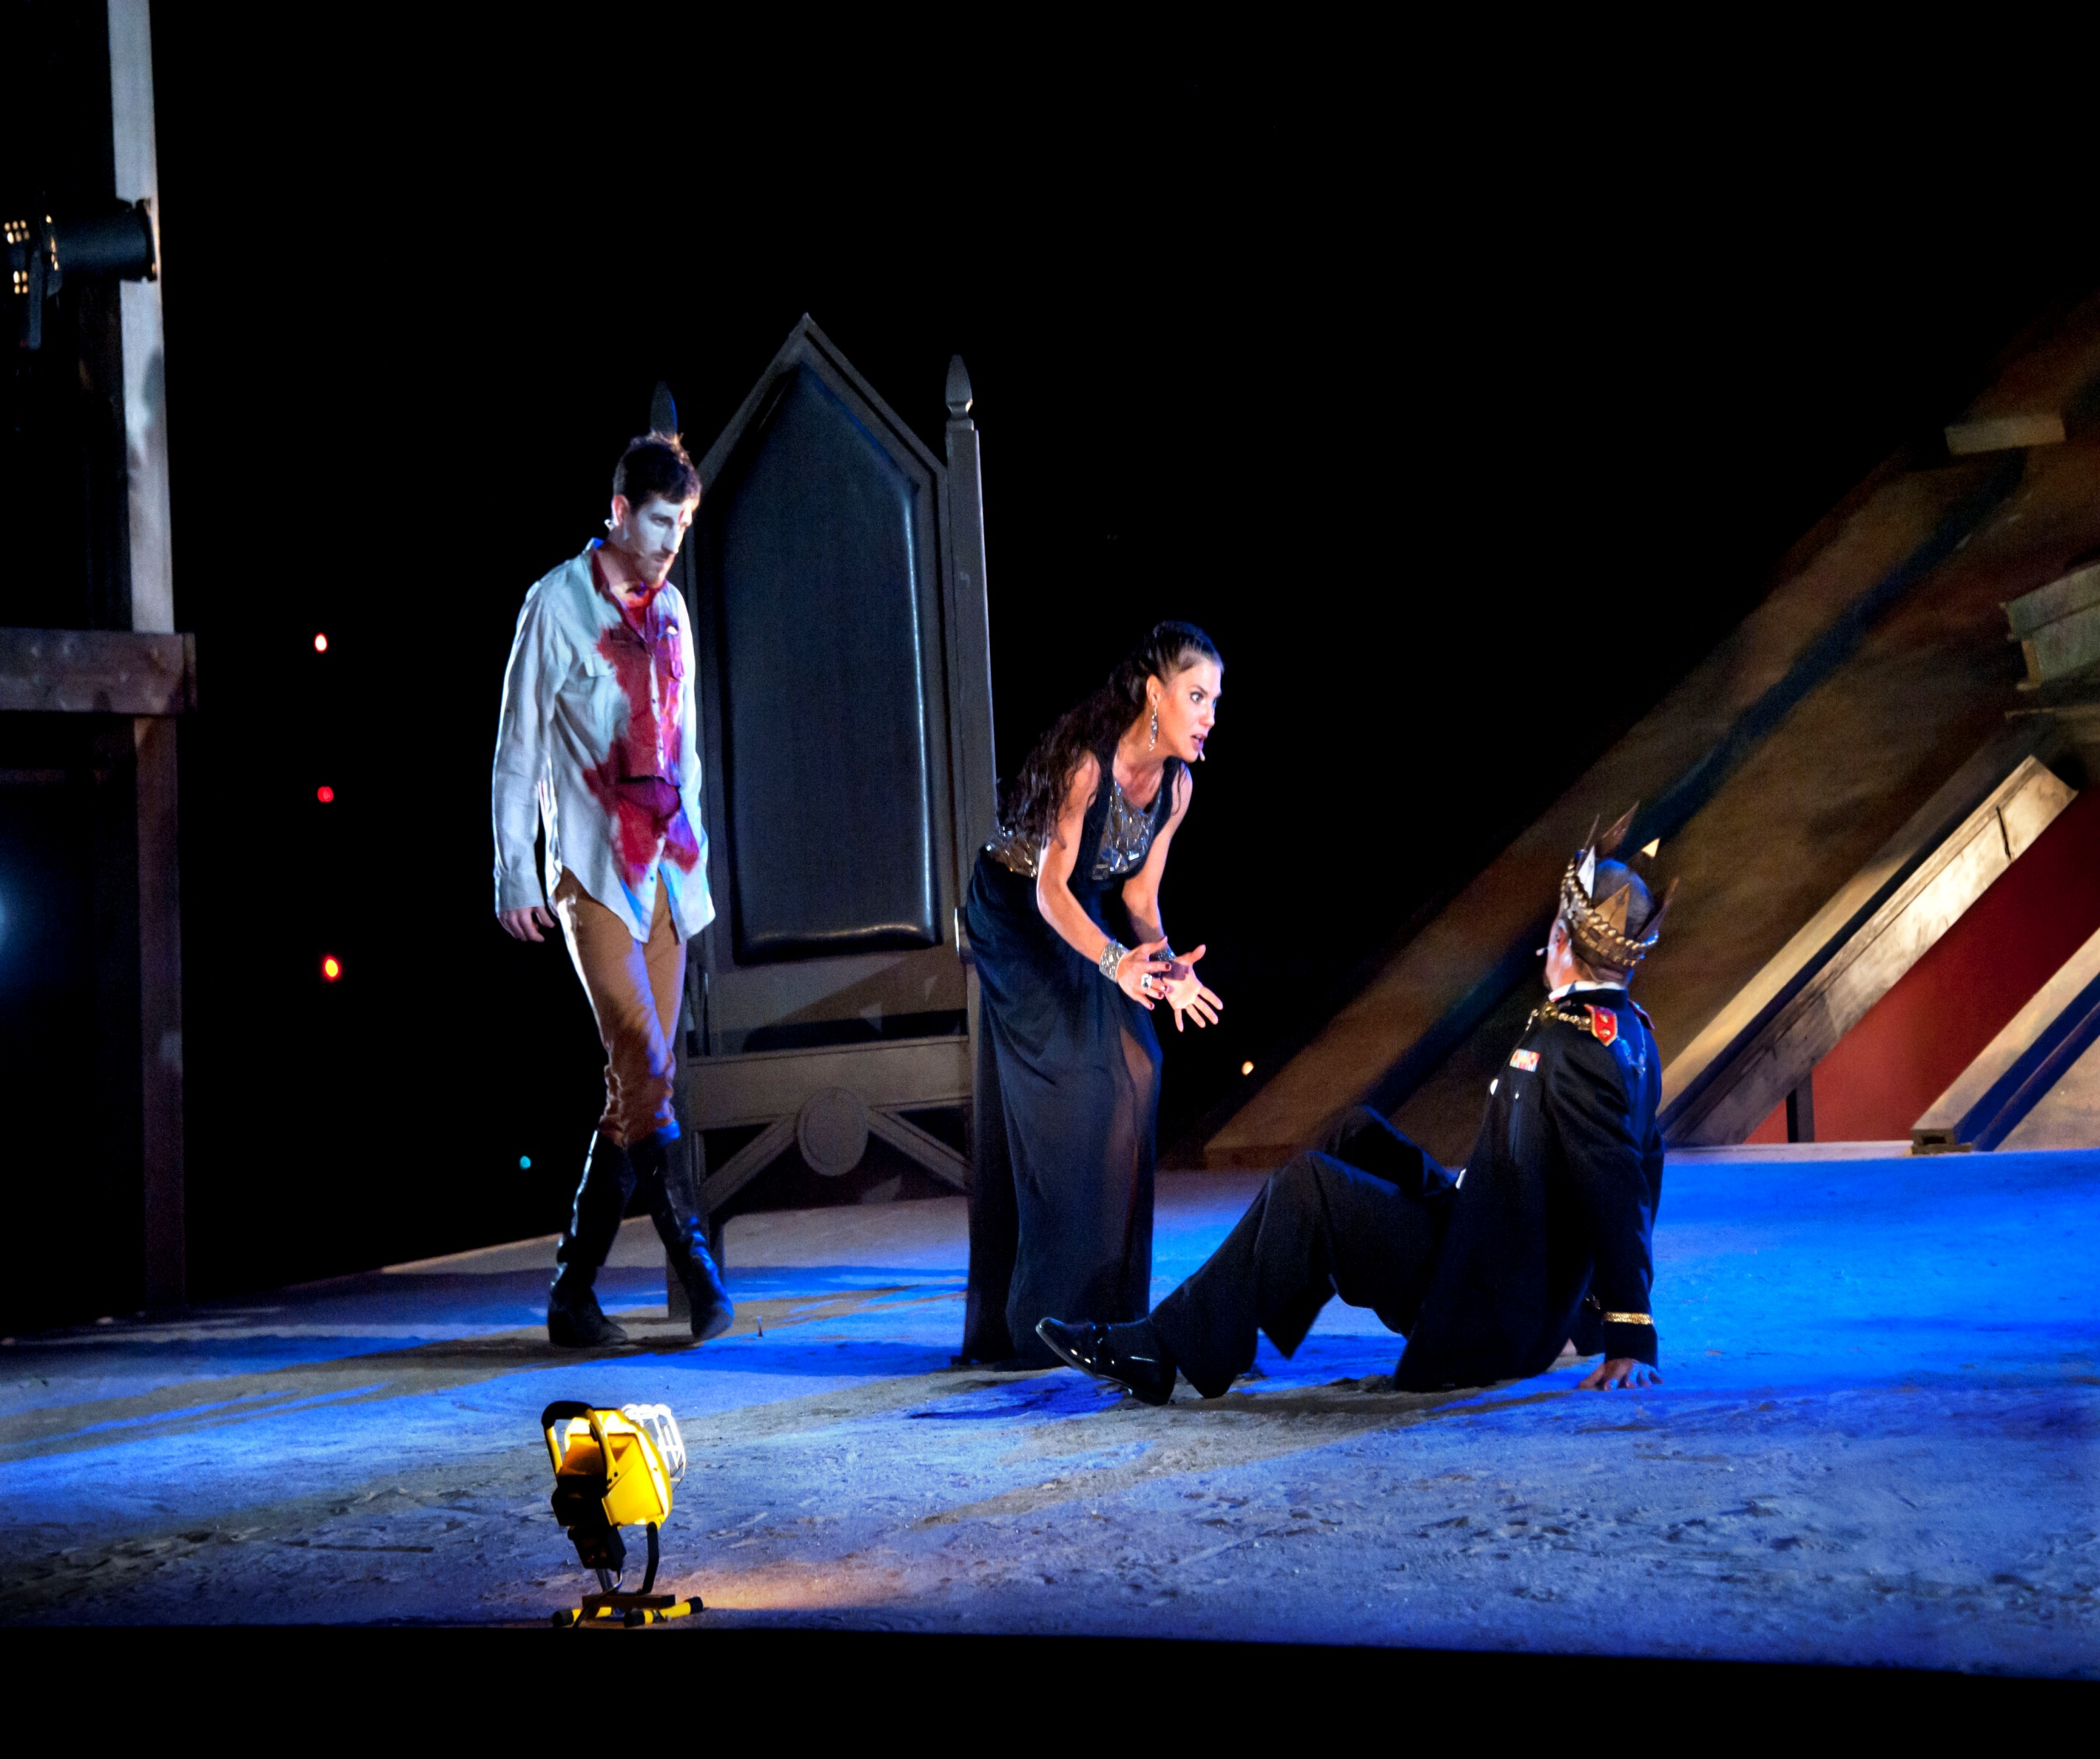
Act Three Scene Four

Slide 39
Banquet prepared. Enter MACBETH, LADY MACBETH, ROSS, LENNOX, LORDS, and attendants.
MACBETH
You know your own degrees; sit down. At first
And last, the hearty welcome.
The LORDS sit
The stage is set for a banquet.
MACBETH
enters with LADY MACBETH,
ROSS, LENNOX,LORDS, and their attendants.
MACBETH
You know your own ranks, so you know where to sit. Sit down. From the highest to the lowest of you, I bid you a hearty welcome.
The LORDS sit down.

Slide 40
LORDS
Thanks to your majesty.
MACBETH
Ourself will mingle with society
And play the humble host.
Our hostess keeps her state, but in best time
We will require her welcome.
LADY MACBETH
Pronounce it for me, sir, to all our friends,
For my heart speaks they are welcome.
LORDS
Thanks to your majesty.
MACBETH
I will walk around and mingle with all of you, playing the humble host. My wife will stay in her royal chair, but at the appropriate time I will have her welcome you all.
LADY MACBETH
Say welcome to all of our friends for me, sir, for in my heart they are all welcome.

Slide 41
Enter FIRST MURDERER at the door
MACBETH
See, they encounter thee with their hearts' thanks.
Both sides are even. Here I’ll sit i' th' midst.
Be large in mirth. Anon we’ll drink a measure
The table round.
(aside to FIRST MURDERER)
There’s blood upon thy face.
The FIRST MURDERER appears at the door.
MACBETH
And they respond to you with their hearts as well. The table is full on both sides. I will sit here in the middle. Be free and happy. Soon we will toast around the table.
(approaching the door and speaking to the MURDERER)
There’s blood on your face.

Slide 42
FIRST MURDERER
'Tis Banquo’s then.
MACBETH
'Tis better thee without than he within.
Is he dispatched?
FIRST MURDERER
My lord, his throat is cut. That I did for him.
MACBETH
Thou art the best o' th' cutthroats:
Yet he’s good that did the like for Fleance.
If thou didst it, thou art the nonpareil.
FIRST MURDERER
Then it must be Banquo’s.
MACBETH
I’d rather see his blood splattered on your face than flowing through his veins. Did you finish him off?
FIRST MURDERER
My lord, his throat is cut. I did that to him.
MACBETH
You are the best of the cutthroats. But whoever did the same to Fleance must also be good. If you cut both their throats, then you are the absolute best.

Slide 43
FIRST MURDERER
Most royal sir, Fleance is ’scaped.
MACBETH
Then comes my fit again. I had else been perfect,
Whole as the marble, founded as the rock,
As broad and general as the casing air.
But now I am cabined, cribbed, confined, bound in
To saucy doubts and fears.—But Banquo’s safe?
FIRST MURDERER
Most royal sir, Fleance has escaped.
MACBETH
Now I’m scared again. Otherwise I would have been perfect, as solid as a piece of marble, as firm as a rock, as free as the air itself. But now I’m all tangled up with doubts and fears. But Banquo’s been taken care of?

Slide 44
FIRST MURDERER
Ay, my good lord. Safe in a ditch he bides,
With twenty trenchèd gashes on his head,
The least a death to nature.
MACBETH
Thanks for that.
There the grown serpent lies. The worm that’s fled
Hath nature that in time will venom breed;
No teeth for th' present. Get thee gone. Tomorrow
We’ll hear ourselves again.
FIRST MURDERER
Yes, my good lord. He’s lying dead in a ditch, with twenty deep gashes in his head, any one of which would have been enough to kill him.
MACBETH
Thanks for that. The adult snake lies in the ditch. The young snake that escaped will in time become poisonous and threatening, but for now he has no fangs. Get out of here. I’ll talk to you again tomorrow.

Slide 45
Exit FIRST MURDERER
LADY MACBETH
My royal lord,
You do not give the cheer. The feast is sold
That is not often vouched, while ’tis a-making,
'Tis given with welcome. To feed were best at home;
From thence, the sauce to meat is ceremony;
Meeting were bare without it.
The FIRST MURDERER exits.
LADY MACBETH
My royal lord, you’re not entertaining the guests. If you don’t make your guests know they’re welcome, they’ll feel like they’re paying for their meal. When you just want to eat, it’s better to do that at home. When you’re eating out with people, you need to have a little more ceremony. Otherwise dinner parties would be boring.

Slide 46
MACBETH
Sweet remembrancer!
Now, good digestion wait on appetite,
And health on both!
LENNOX
May ’t please your highness sit.
Enter the GHOST OF BANQUO, and sits in MACBETH’s place
MACBETH
It’s nice of you to remind me. (raising a glass to toast his guests) Since good digestion requires a good appetite, and good health requires both of those, here’s to good appetites, good digestion, and good health!
LENNOX
Why don’t you have a seat, your highness?
The GHOST OF BANQUO enters and sits in MACBETH’s place.

Slide 47
MACBETH
Here had we now our country’s honor roofed,
Were the graced person of our Banquo present,
Who may I rather challenge for unkindness
Than pity for mischance.
ROSS
His absence, sir,
Lays blame upon his promise. Please ’t your highness
To grace us with your royal company?
MACBETH
We would have all the nobility of Scotland gathered under one roof, if only Banquo were here. I hope it turns out that he’s late out of rudeness, and not because something bad has happened to him.
ROSS
His absence means he’s broken his promise, sir. If it pleases you, your highness, why don’t you sit with us and grace us with your royal company?

Slide 48
MACBETH
The table’s full.
LENNOX
Here is a place reserved, sir.
MACBETH
Where?
LENNOX
Here, my good lord. What is ’t that moves your highness?
MACBETH
Which of you have done this?
MACBETH
The table’s full.
LENNOX
Here’s an empty seat, sir.
MACBETH
Where?
LENNOX
(pointing to where the GHOST sits) Here, my good lord. What’s wrong, your highness?
MACBETH
(seeing the GHOST) Which one of you did this?

Slide 49
MACBETH
(to GHOST) Thou canst not say I did it. Never shake
Thy gory locks at me.
ROSS
Gentlemen, rise. His highness is not well.
MACBETH
(to the GHOST) You can’t say I did it. Don’t shake your bloody head at me.
ROSS
Gentlemen, stand up. His highness is not well.

Slide 50
LADY MACBETH
Sit, worthy friends. My lord is often thus
And hath been from his youth. Pray you, keep seat.
The fit is momentary; upon a thought
He will again be well. If much you note him,
You shall offend him and extend his passion.
Feed and regard him not.
(aside to MACBETH) Are you a man?
LADY MACBETH
Sit down, worthy friends. My husband is often like this, and he has been since he was a child. Please stay seated. This is just a brief fit. In a moment he’ll be well again. If you pay too much attention to him you’ll make him angry, and that will make his convulsions go on longer. Eat your dinner and pay no attention to him.
(speaking so that only MACBETH can hear) Are you a man?

Slide 51
MACBETH
Ay, and a bold one, that dare look on that
Which might appall the devil.
LADY MACBETH
O proper stuff!
This is the very painting of your fear.
This is the air-drawn dagger which you said
Led you to Duncan. Oh, these flaws and starts,
Impostors to true fear, would well become
A woman’s story at a winter’s fire,
Authorized by her grandam. Shame itself!
Why do you make such faces? When all’s done,
You look but on a stool.
ACBETH
Yes, and a brave one, who dares to look at something that would frighten the devil.
LADY MACBETH
Oh, that’s nonsense! This is just another one of the hallucinations you always get when you’re afraid. This is like that floating dagger you said was leading you toward Duncan. These outbursts of yours don’t even look like real fear. They’re more like how you would act if you were a woman telling a scary story by the fireside in front of her grandmother. Shame on you! Why are you making these faces? When the vision passes, you’ll see that you’re just looking at a stool.

Slide 52
MACBETH
Prithee, see there! Behold! Look! Lo! How say you?
Why, what care I? If thou canst nod, speak too.
If charnel houses and our graves must send
Those that we bury back, our monuments
Shall be the maws of kites.
Exit GHOST
MACBETH
Please, just look over there. Look! Look! See! (to the GHOST) What do you have to say? What do I care? If you can nod, then speak too. If the dead are going to return from their graves, then there’s nothing to stop the birds from eating the bodies. So there’s no point in our burying people.
The GHOST vanishes.

Slide 53
LADY MACBETH
What, quite unmanned in folly?
MACBETH
If I stand here, I saw him.
LADY MACBETH
Fie, for shame!
LADY MACBETH
What, has your foolishness paralyzed you completely?
MACBETH
As sure as I’m standing here, I saw him.
LADY MACBETH
Nonsense!

Slide 54
MACBETH
Blood hath been shed ere now, i' th' olden time,
Ere humane statute purged the gentle weal;
Ay, and since too, murders have been performed
Too terrible for the ear. The time has been
That, when the brains were out, the man would die,
And there an end. But now they rise again
With twenty mortal murders on their crowns
And push us from our stools. This is more strange
Than such a murder is.
MACBETH
In ancient times, before there were laws to make the land safe and peaceful, a lot of blood was spilled. Yes, and since then murders have been committed that are too awful to talk about. It used to be that when you knocked a man’s brains out he would just die, and that would be it. But now they rise from the dead with twenty fatal head wounds and push us off our stools. This haunting business is even stranger than murder.

Slide 55
LADY MACBETH
My worthy lord,
Your noble friends do lack you.
MACBETH
I do forget.
Do not muse at me, my most worthy friends.
I have a strange infirmity, which is nothing
To those that know me. Come, love and health to all.
Then I’ll sit down. Give me some wine. Fill full.
Enter the GHOST OF BANQUO
LADY MACBETH
My worthy lord, your noble friends miss your company.
MACBETH
I forgot about them. (to the guests) Don’t be alarmed on my account, my most worthy friends. I have a strange disorder, which no longer shocks those who know me well. (raising his glass to toast the company) Come, let’s drink a toast: love and health to you all. Now I’ll sit down. Give me some wine. Fill up my cup.
The GHOST OF BANQUO reappears in MACBETH’s seat.

Slide 56
MACBETH
I drink to the general joy o' th' whole table,
And to our dear friend Banquo, whom we miss;
Would he were here! To all and him we thirst,
And all to all.
LORDS
Our duties, and the pledge.
They drink
MACBETH
I drink to the happiness of everyone at the table, and to our dear friend Banquo, whom we miss. I wish he were here! Let’s drink to everyone here, and to Banquo. Now, everybody, drink
LORDS
Hear, hear.
They drink.

Slide 57
MACBETH
(seeing the GHOST) Avaunt, and quit my sight! Let the earth hide thee.
Thy bones are marrowless, thy blood is cold.
Thou hast no speculation in those eyes
Which thou dost glare with!
LADY MACBETH
Think of this, good peers,
But as a thing of custom. 'Tis no other;
Only it spoils the pleasure of the time.
MACBETH
(to the GHOST) Go! And get out of my sight! Stay in your grave. There’s no marrow in your bones, and your blood is cold. You’re staring at me with eyes that have no power to see.
LADY MACBETH
Good friends, think of this as nothing more than a strange habit. It’s nothing else. Too bad it’s spoiling our pleasure tonight.

Slide 58
MACBETH
What man dare, I dare.
Approach thou like the rugged Russian bear,
The armed rhinoceros, or th' Hyrcan tiger;
Take any shape but that, and my firm nerves
Shall never tremble. Or be alive again,
And dare me to the desert with thy sword.
If trembling I inhabit then, protest me
The baby of a girl. Hence, horrible shadow!
Unreal mockery, hence!
MACBETH
I am as brave as any other man. Come at me in the form of a rugged Russian bear, an armor-plated rhinoceros, or a tiger from Iran. Take any shape other than the one you have now and I will never tremble in fear. Or come back to life again and challenge me to a duel in some deserted place. If I tremble then, you can call me a little girl. Get out of here, you horrible ghost, you hallucination. Get out!

Slide 59
Exit GHOST
MACBETH
Why so, being gone,
Why so, being gone,
I am a man again. Pray you sit still.
LADY MACBETH
You have displaced the mirth, broke the good meeting,
With most admired disorder.
The GHOST vanishes.
MACBETH
I am a man again. Pray you sit still.
Look, now that it’s gone, I’m a man again. Please, remain seated.
LADY MACBETH
You have ruined our good cheer and disrupted the gathering by making a spectacle of yourself.

Slide 60
MACBETH
Can such things be,
And overcome us like a summer’s cloud,
Without our special wonder? You make me strange
Even to the disposition that I owe,
When now I think you can behold such sights,
And keep the natural ruby of your cheeks,
When mine is blanched with fear.
ROSS
What sights, my lord?
MACBETH
(to the guests) Can things like this happen so suddenly without making us all astonished? You make me feel like I don’t know myself, when I see you looking at these terrible things and keeping a straight face, while my face has gone white with fear.
ROSS
What things, my lord?

Slide 61
LADY MACBETH
I pray you, speak not. He grows worse and worse.
Question enrages him. At once, good night.
Stand not upon the order of your going,
But go at once.
LENNOX
Good night, and better health
Attend his majesty!
LADY MACBETH
A kind good night to all!
Exeunt all but MACBETH and LADY MACBETH
LADY MACBETH
Please, don’t speak to him. He’s getting worse and worse. Talk makes him crazy. Everybody, please leave right now. Don’t bother exiting in the order of your rank, but just leave right away.
LENNOX
Good night. I hope the king recovers soon!
LADY MACBETH
A kind good night to all!
Everyone leaves except MACBETH and LADY MACBETH.

Slide 62
MACBETH
It will have blood, they say. Blood will have blood.
Stones have been known to move, and trees to speak.
Augurs and understood relations have
By magot pies and choughs and rooks brought forth
The secret’st man of blood.—What is the night?
LADY MACBETH
Almost at odds with morning, which is which.
MACBETH
How say’st thou that Macduff denies his person
At our great bidding?
MACBETH
There’s an old saying: the dead will have their revenge. Gravestones have been known to move, and trees to speak, to bring guilty men to justice. The craftiest murderers have been exposed by the mystical signs made by crows and magpies. How late at night is it?
LADY MACBETH
It’s almost morning. You can’t tell whether it’s day or night.
MACBETH
What do you think about the fact that Macduff refuses to come to me when I command him?

Slide 63
LADY MACBETH
Did you send to him, sir?
MACBETH
I hear it by the way; but I will send.
There’s not a one of them but in his house
I keep a servant fee’d. I will tomorrow—
And betimes I will—to the weird sisters.
More shall they speak, for now I am bent to know,
By the worst means, the worst. For mine own good,
All causes shall give way. I am in blood
Stepped in so far that, should I wade no more,
Returning were as tedious as go o'er.
Strange things I have in head, that will to hand,
Which must be acted ere they may be scanned.
LADY MACBETH
Did you send for him, sir?
MACBETH
I’ve heard about this indirectly, but I will send for him. In every one of the lords' households I have a servant paid to spy for me. Tomorrow, while it’s still early, I will go see the witches. They will tell me more, because I’m determined to know the worst about what’s going to happen. My own safety is the only important thing now. I have walked so far into this river of blood that even if I stopped now, it would be as hard to go back to being good as it is to keep killing people. I have some schemes in my head that I’m planning to put into action. I have to do these things before I have a chance to think about them.

Slide 64
LADY MACBETH
You lack the season of all natures, sleep.
MACBETH
Come, we’ll to sleep. My strange and self-abuse
Is the initiate fear that wants hard use.
We are yet but young in deed.
Exeunt
LADY MACBETH
You haven’t slept.
MACBETH
Yes, let’s go to sleep. My strange self-delusions just come from inexperience. We’re still just beginners when it comes to crime.
They exit.

Slide 65
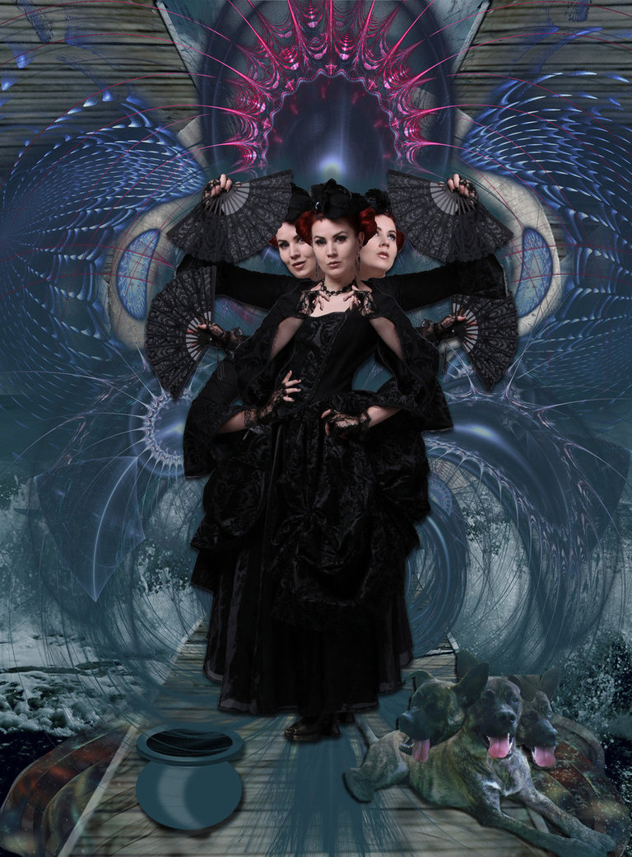
Act Three Scene Five

Slide 66
Thunder. Enter the three WITCHES meeting HECATE
FIRST WITCH
Why, how now, Hecate! You look angerly.
HECATE
Have I not reason, beldams as you are?
Saucy and overbold, how did you dare
To trade and traffic with Macbeth
In riddles and affairs of death,
And I, the mistress of your charms,
The close contriver of all harms,
Was never called to bear my part,
Or show the glory of our art?
Thunder. The three WITCHES enter, meeting HECATE.
FIRST WITCH
What’s wrong, Hecate? You look angry.
HECATE
Don’t I have a reason to be angry, you disobedient hags? How dare you give Macbeth riddles and prophecies about his future without telling me? I am your boss and the source of your powers. I am the one who secretly decides what evil things happen, but you never called me to join in and show off my own powers.

Slide 67
HECATE
And, which is worse, all you have done
Hath been but for a wayward son,
Spiteful and wrathful, who, as others do,
Loves for his own ends, not for you.
But make amends now. Get you gone,
And at the pit of Acheron
Meet me i' th' morning. Thither he
Will come to know his destiny.
Your vessels and your spells provide,
Your charms and everything beside.
I am for the air. This night I’ll spend
Unto a dismal and a fatal end.
Great business must be wrought ere noon.
Upon the corner of the moon
There hangs a vap'rous drop profound.
I’ll catch it ere it come to ground.
And that distilled by magic sleights
Shall raise such artificial sprites
As by the strength of their illusion
Shall draw him on to his confusion.
HECATE
And what’s worse, you’ve done all this for a man who behaves like a spoiled brat, angry and hateful. Like all spoiled sons, he chases after what he wants and doesn’t care about you. But you can make it up to me. Go away now and in the morning meet me in the pit by the river in hell. Macbeth will go there to learn his destiny. You bring your cauldrons, your spells, your charms, and everything else. I’m about to fly away. I’ll spend tonight working to make something horrible happen. I have a lot to do before noon. An important droplet is hanging from the corner of the moon. I’ll catch it before it falls to the ground. When I work it over with magic spells, the drop will produce magical spirits that will trick Macbet

Slide 68
HECATE
He shall spurn fate, scorn death, and bear
His hopes 'bove wisdom, grace, and fear.
And you all know, security
Is mortals' chiefest enemy.
Music and a song within: 'Come away, come away,' &c
Hark! I am called. My little spirit, see,
Sits in a foggy cloud and stays for me.
Exit
FIRST WITCH
Come, let’s make haste; she’ll soon be back again.
Exeunt
HECATE
He will be fooled into thinking he is greater than fate, he will mock death, and he will think he is above wisdom, grace, and fear. As you all know, overconfidence is man’s greatest enemy.
Music plays offstage, and voices sing a song with the words “Come away, come away.”
Listen! I’m being called. Look, my little spirit is sitting in a foggy cloud waiting for me.
HECATE exits.
FIRST WITCH
Come on, let’s hurry. She’ll be back again soon.
They all exit.

Slide 69
Act Three Scene Six

Slide 70
Enter LENNOX and another LORD
LENNOX
My former speeches have but hit your thoughts,
Which can interpret farther. Only I say
Things have been strangely borne. The gracious Duncan
Was pitied of Macbeth. Marry, he was dead.
And the right-valiant Banquo walked too late,
Whom, you may say, if ’t please you, Fleance killed,
For Fleance fled. Men must not walk too late.
Who cannot want the thought how monstrous
It was for Malcolm and for Donalbain
To kill their gracious father?
LENNOX and another LORD enter.
LENNOX
What I’ve already said shows you we think alike, so you can draw your own conclusions. All I’m saying is that strange things have been going on. Macbeth pitied Duncan—after Duncan was dead. And Banquo went out walking too late at night. If you like, we can say that Fleance must have killed him, because Fleance fled the scene of the crime. Clearly, men should not go out walking too late! And who can help thinking how monstrous it was for Malcolm and Donalbain to kill their gracious father?

Slide 71
LENNOX
Damnèd fact!
How it did grieve Macbeth! Did he not straight
In pious rage the two delinquents tear
That were the slaves of drink and thralls of sleep?
Was not that nobly done? Ay, and wisely too,
For ’twould have angered any heart alive
To hear the men deny ’t. So that, I say,
He has borne all things well. And I do think
That had he Duncan’s sons under his key—
As, an’t please heaven, he shall not—they should find
What ’twere to kill a father. So should Fleance.
But, peace! For from broad words, and 'cause he failed
His presence at the tyrant’s feast, I hear
Macduff lives in disgrace. Sir, can you tell
Where he bestows himself?
LENNOX
Such a heinous crime—how it saddened Macbeth! Wasn’t it loyal of him to kill those two servants right away, while they were still drunk and asleep? That was the right thing to do, wasn’t it? Yes, and it was the wise thing, too, because we all would have been outraged to hear those two deny their crime. Considering all this, I think Macbeth has handled things well. If he had Duncan’s sons in prison—which I hope won’t happen—they would find out how awful the punishment is for those who kill their fathers, and so would Fleance. But enough of that. I hear that Macduff is out of favor with the king because he speaks his mind too plainly, and because he failed to show up at Macbeth’s feast. Can you tell me where he’s hiding himself?

Slide 72
LORD
The son of Duncan—
From whom this tyrant holds the due of birth—
Lives in the English court and is received
Of the most pious Edward with such grace
That the malevolence of fortune nothing
Takes from his high respect.
LORD
Duncan’s son Malcolm, whose birthright and throne Macbeth has stolen, lives in the English court. There, the saintly King Edward treats Malcolm so well that despite Malcolm’s misfortunes, he’s not deprived of respect.

Slide 73
LORD
Thither Macduff
Is gone to pray the holy king upon his aid
To wake Northumberland and warlike Siward,
That by the help of these—with Him above
To ratify the work—we may again
Give to our tables meat, sleep to our nights,
Free from our feasts and banquets bloody knives,
Do faithful homage and receive free honors.
All which we pine for now. And this report
Hath so exasperated the king that he
Prepares for some attempt of war.
LORD
Macduff went there to ask King Edward for help. He wants Edward to help him form an alliance with the people of Northumberland and their lord, Siward. Macduff hopes that with their help—and with the help of God above—he may once again put food on our tables, bring peace back to our nights, free our feasts and banquets from violent murders, allow us to pay proper homage to our king, and receive honors freely. Those are the things we pine for now. Macbeth has heard this news and he is so angry that he’s preparing for war.

Slide 74
LENNOX
Sent he to Macduff?
LORD
He did, and with an absolute “Sir, not I,”
The cloudy messenger turns me his back,
And hums, as who should say “You’ll rue the time
That clogs me with this answer.”
LENNOX
Did he tell Macduff to return to Scotland?
LORD
He did, but Macduff told the messenger, “No way.” The messenger scowled and rudely turned his back on Macduff, as if to say, “You’ll regret the day you gave me this answer.”

Slide 75
LENNOX
And that well might
Advise him to a caution, t' hold what distance
His wisdom can provide. Some holy angel
Fly to the court of England and unfold
His message ere he come, that a swift blessing
May soon return to this our suffering country
Under a hand accursed!
LENNOX
That might well keep Macduff away from Scotland. Some holy angel should go to the court of England and give Macduff a message. He should return quickly to free our country, which is suffering under a tyrant!

Slide 76
LORD
I’ll send my prayers with him.
Exeunt
LORD
I’ll send my prayers with him.
They exit.

