Slide 1
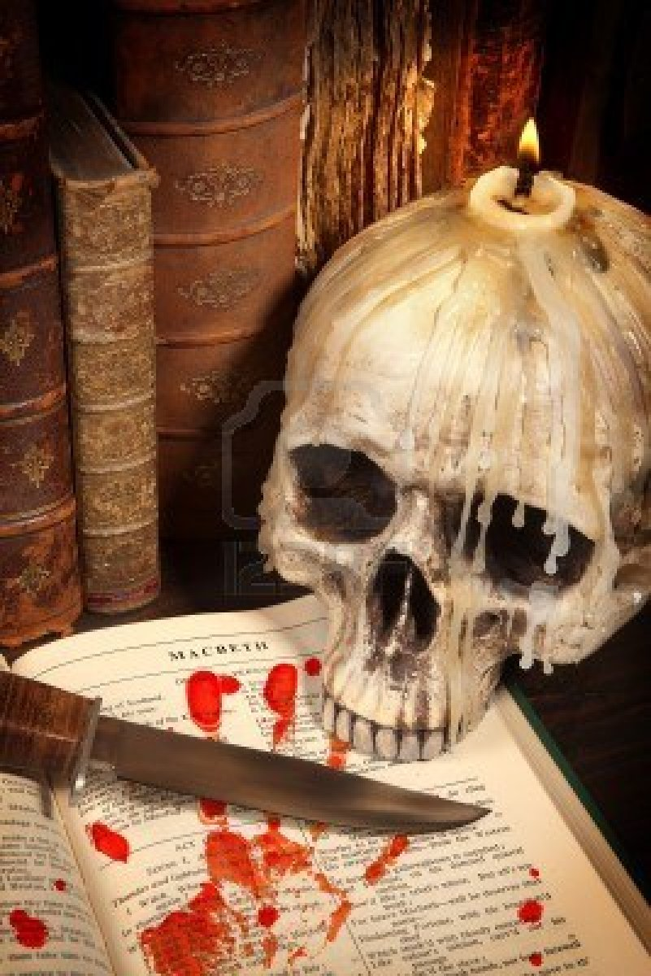
The Tragedy of Macbeth

Slide 2
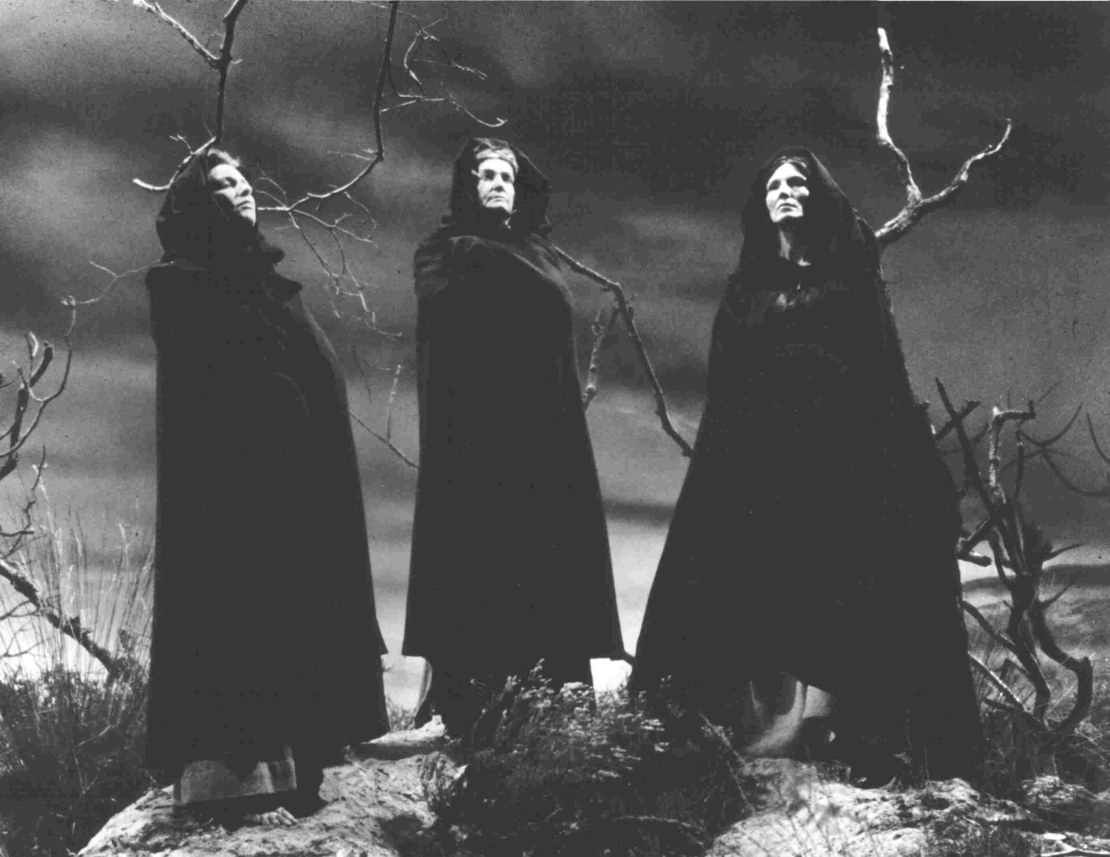
Act One Scene One

Slide 3
Casting Call
1st Witch
Dr. Armbrister
Don Dunn
2nd Witch
Mastah Chi
Dr. Leez
3rd Witch
Dr. Davis
Dr. Dr. Who Phillips

Slide 4
Thunder and lightning. Three WITCHES enter
FIRST WITCH
When shall we three meet again?
In thunder, lightning, or in rain?
SECOND WITCH
When the hurly-burly’s done,
When the battle’s lost and won.
THIRD WITCH
That will be ere the set of sun.
Thunder and lightning. Three WITCHES enter
FIRST WITCH
When should the three of us meet again? Will it be in thunder, lightning, or rain?
SECOND WITCH
We’ll meet when the noise of the battle is over, when one side has won and the other side has lost.
THIRD WITCH
That will happen before sunset.

Slide 5
FIRST WITCH
Where the place?
SECOND WITCH
Upon the heath.
THIRD WITCH
There to meet with Macbeth.
The WITCHES hear the calls of their spirit friends or “familiars,” which look like animals—one is a cat and one is a toad.
FIRST WITCH
Where should we meet?
SECOND WITCH
Let’s do it in the open field.
THIRD WITCH
We’ll meet Macbeth there.
The WITCHES hear the calls of their spirit friends or “familiars,” which look like animals—one is a cat and one is a toad.

Slide 6
FIRST WITCH
I come, Graymalkin!
SECOND WITCH
Paddock calls.
THIRD WITCH
Anon.
ALL
Fair is foul, and foul is fair
Hover through the fog and filthy air.
They exit.
FIRST WITCH
(calling to her cat) I’m coming, Graymalkin!
SECOND WITCH
My toad, Paddock, calls me.
THIRD WITCH
(to her spirit) I’ll be right here!
ALL
Fair is foul, and foul is fair. Let’s fly away through the fog and filthy air.
They exit.

Slide 7
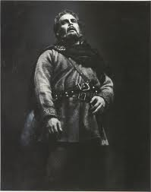
Act One Scene Two

Slide 8
Casting Call
King Duncan (hail to the king, baby)
Dr. Armbrister
Dr. Thurman
Malcolm (Duncan’s son)
Dr. Brown
Dr. Speed
Captain (some dude who bites it)
Dr. Maples
Prof. Ballenger
Ross (a “thane” which is like a governor)
Dr. Davis
Dr. Silveria
Angus (another “thane”)
Dr. Chi

Slide 9
Sounds of a trumpet and soldiers fighting offstage. KING DUNCAN enters with his sons MALCOLM and DONALBAIN, LENNOX, and a number of attendants. They meet a wounded and bloody CAPTAIN.
DUNCAN
What bloody man is that? He can report,
As seemeth by his plight, of the revolt
The newest state.
MALCOLM
This is the sergeant
Who like a good and hardy soldier fought
'Gainst my captivity. Hail, brave friend!
Say to the king the knowledge of the broil
As thou didst leave it.
Sounds of a trumpet and soldiers fighting offstage. KING DUNCAN enters with his sons MALCOLM and DONALBAIN, LENNOX, and a number of attendants. They meet a wounded and bloody CAPTAIN.
DUNCAN
Who is this bloody man? Judging from his appearance, I bet he can tell us the latest news about the revolt.
MALCOLM
This is the brave sergeant who fought to keep me from being captured. Hail, brave friend! Tell the king what was happening in the battle when you left it.

Slide 10
CAPTAIN
Doubtful it stood,
As two spent swimmers that do cling together
And choke their art. The merciless Macdonwald—
Worthy to be a rebel, for to that
The multiplying villanies of nature
Do swarm upon him—from the Western Isles
Of kerns and gallowglasses is supplied,
And fortune, on his damnèd quarrel smiling,
Showed like a rebel’s whore. But all’s too weak,
For brave Macbeth—well he deserves that name—
Disdaining fortune, with his brandished steel,
Which smoked with bloody execution,
Like valor’s minion carved out his passage
Till he faced the slave;
Which ne'er shook hands, nor bade farewell to him,
Till he unseamed him from the nave to th' chops,
And fixed his head upon our battlements.
CAPTAIN
For a while you couldn’t tell who would win. The armies were like two exhausted swimmers clinging to each other and struggling in the water, unable to move. The villainous rebel Macdonwald was supported by foot soldiers and horsemen from Ireland and the Hebrides, and Lady Luck was with him, smiling cruelly at his enemies as if she were his whore. But Luck and Macdonwald together weren’t strong enough. Brave Macbeth, laughing at Luck, chopped his way through to Macdonwald, who didn’t even have time to say good-bye or shake hands before Macbeth split him open from his navel to his jawbone and stuck his head on our castle walls.

Slide 11
DUNCAN
O valiant cousin! Worthy gentleman!
CAPTAIN
As whence the sun 'gins his reflection
Shipwracking storms and direful thunders break,
So from that spring whence comfort seemed to come
Discomfort swells. Mark, King of Scotland, mark:
No sooner justice had, with valor armed,
Compelled these skipping kerns to trust their heels,
But the Norweyan lord, surveying vantage,
With furbished arms and new supplies of men,
Began a fresh assault.
DUNCAN
My brave relative! What a worthy man!
CAPTAIN
But in the same way that violent storms always come just as spring appears, our success against Macdonwald created new problems for us. Listen to this, King: as soon as we sent those Irish soldiers running for cover, the Norwegian king saw his chance to attack us with fresh troops and shiny weapons.

Slide 12
DUNCAN
Dismayed not this our captains, Macbeth and Banquo?
CAPTAIN
Yes, as sparrows eagles, or the hare the lion.
If I say sooth, I must report they were
As cannons overcharged with double cracks,
So they doubly redoubled strokes upon the foe.
Except they meant to bathe in reeking wounds,
Or memorize another Golgotha,
I cannot tell—
But I am faint, my gashes cry for help.
DUNCAN
Didn’t this frighten our captains, Macbeth and Banquo?
CAPTAIN
The new challenge scared them about as much as sparrows frighten eagles, or rabbits frighten a lion. To tell you the truth, they fought the new enemy with twice as much force as before; they were like cannons loaded with double ammunition. Maybe they wanted to take a bath in their enemies' blood, or make that battlefield as infamous as Golgotha, where Christ was crucified, I don’t know. But I feel weak. My wounds must be tended to.

Slide 13
DUNCAN
So well thy words become thee as thy wounds;
They smack of honor both. Go get him surgeons.
Who comes here?
The CAPTAIN exits, helped by attendants.
ROSS and ANGUS enter
MALCOLM
The worthy Thane of Ross.
DUNCAN
Your words, like your wounds, bring you honor. Take him to the surgeons.
Who is this?
The CAPTAIN exits, helped by attendants.
ROSS and ANGUS enter
MALCOLM
The worthy Thane of Ross.

Slide 14
LENNOX
What a haste looks through his eyes! So should he look
That seems to speak things strange.
ROSS
God save the king.
DUNCAN
Whence cam’st thou, worthy thane?
LENNOX
His eyes seem frantic! He looks like someone with a strange tale to tell.
ROSS
God save the king!
DUNCAN
Where have you come from, worthy thane?

Slide 15
ROSS
From Fife, great king,
Where the Norweyan banners flout the sky
And fan our people cold.
Norway himself, with terrible numbers,
Assisted by that most disloyal traitor,
The thane of Cawdor, began a dismal conflict,
Till that Bellona’s bridegroom, lapped in proof,
Confronted him with self-comparisons,
Point against point, rebellious arm 'gainst arm,
Curbing his lavish spirit; and to conclude,
The victory fell on us.
ROSS
Great king, I’ve come from Fife, where the Norwegian flag flies, mocking our country and frightening our people. Leading an enormous army and assisted by that disloyal traitor, the thane of Cawdor, the king of Norway began a bloody battle. But outfitted in his battle-weathered armor, Macbeth met the Norwegian attacks shot for shot, as if he were the goddess of war’s husband. Finally he broke the enemy’s spirit, and we were victorious.

Slide 16
DUNCAN
Great happiness!
ROSS
That now
Sweno, the Norways' king, craves composition.
Nor would we deign him burial of his men
Till he disbursed at Saint Colme’s Inch
Ten thousand dollars to our general use.
DUNCAN
No more that thane of Cawdor shall deceive
Our bosom interest: go pronounce his present death,
And with his former title greet Macbeth.
DUNCAN
Great happiness!
ROSS
So now Sweno, the Norwegian king, wants a treaty. We told him we wouldn’t even let him bury his men until he retreated to Saint Colme’s Inch and paid us ten thousand dollars.
DUNCAN
The thane of Cawdor will never again betray me. Go announce that he will be executed, and tell Macbeth that Cawdor’s titles will be given to him.

Slide 17
ROSS
I’ll see it done.
DUNCAN
What he hath lost, noble Macbeth hath won.
Exeunt
ROSS
I’ll get it done right away.
DUNCAN
The thane of Cawdor has lost what the noble Macbeth has won.
They all exit.

Slide 18
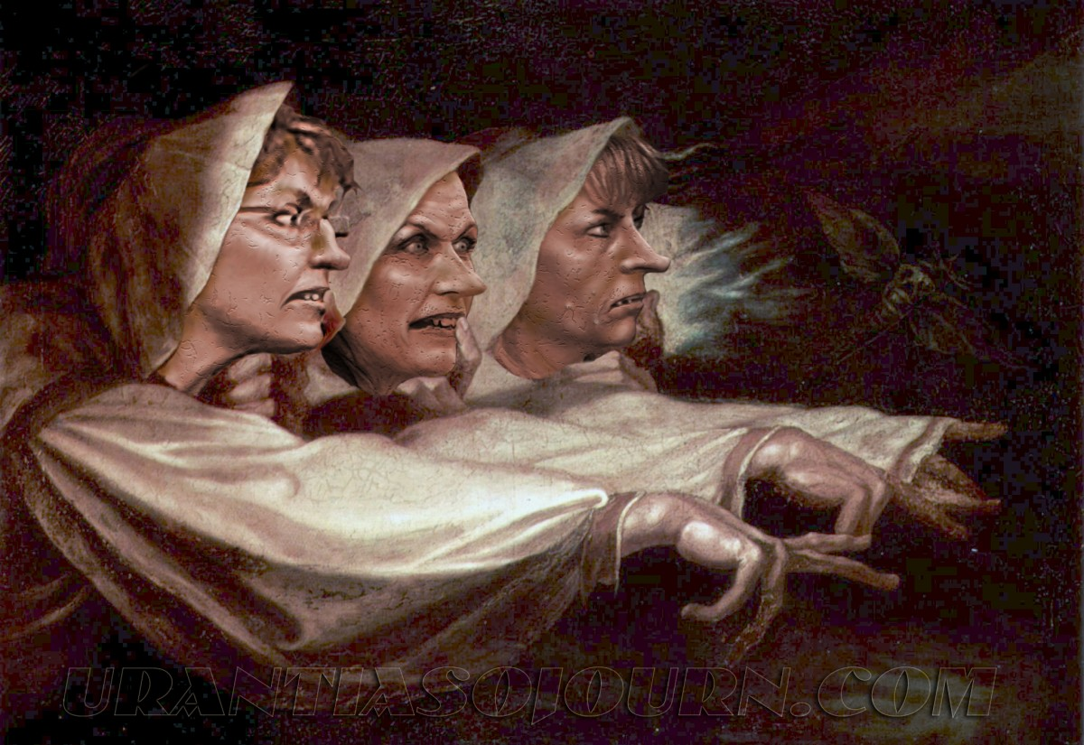
Act One Scene Three

Slide 19
Casting Call
1st Witch
Cheyenne
Dr. Phillips Head The Screwdirver
2nd Witch
Scotticus The Impaler
Dr. Speediest
3rd Witch
The Maplenator
Dr. Lambast
Macbeth (the “Thane” of Glamis, and a hella good fighter)
Mr. Brewer because laziness
Dr. Webbinator
Banquo (Macbeth’s best friend #SQUADFERLIFE)
Straned Hairris
Don Dunn
Ross (another “thane”
Various Buckners read the easy stuff
Major Silveria
Angus (not a hamburger, another “thane”)
Dr. Davis
Dr. Myers

Slide 20
Thunder. The three WITCHES enter.
FIRST WITCH
Where hast thou been, sister?
SECOND WITCH
Killing swine.
THIRD WITCH
Sister, where thou?
FIRST WITCH
A sailor’s wife had chestnuts in her lap,
And munched, and munched, and munched. “Give me,” quoth I.
“Aroint thee, witch!” the rump-fed runnion cries.
Her husband’s to Aleppo gone, master o' th' Tiger;
But in a sieve I’ll thither sail,
And like a rat without a tail,
I’ll do, I’ll do, and I’ll do.
Thunder. The three WITCHES enter.
FIRST WITCH
Where have you been, sister?
SECOND WITCH
Killing pigs.
THIRD WITCH
And you, sister?
FIRST WITCH
A sailor’s wife had chestnuts in her lap and munched away at them. “Give me one,” I said. “Get away from me, witch!” the fat woman cried. Her husband has sailed off to Aleppo as master of a ship called the Tiger. I’ll sail there in a kitchen strainer, turn myself into a tailless rat, and do things to him—

Slide 21
SECOND WITCH
I’ll give thee a wind.
FIRST WITCH
Thou 'rt kind.
THIRD WITCH
And I another.
FIRST WITCH
I myself have all the other,
And the very ports they blow,
All the quarters that they know
I' th' shipman’s card.
I’ll drain him dry as hay.
Sleep shall neither night nor day
Hang upon his penthouse lid.
He shall live a man forbid.
Weary sev'nnights nine times nine
Shall he dwindle, peak and pine.
Though his bark cannot be lost,
Yet it shall be tempest-tossed.
Look what I have.
SECOND WITCH
I’ll give you some wind to sail there.
FIRST WITCH
How nice of you!
THIRD WITCH
And I will give you some more.
FIRST WITCH
I already have control of all the other winds, along with the ports from which they blow and every direction on the sailor’s compass in which they can go. I’ll drain the life out of him. He won’t catch a wink of sleep, either at night or during the day. He will live as a cursed man. For eighty-one weeks he will waste away in agony.
Although I can’t make his ship disappear, I can still make his journey miserable. Look what I have here.

Slide 22
SECOND WITCH
Show me, show me.
FIRST WITCH
Here I have a pilot’s thumb,
Wrecked as homeward he did come.
Drum within
THIRD WITCH
A drum, a drum!
Macbeth doth come.
ALL
(dancing together in a circle) The weird sisters, hand in hand,
Posters of the sea and land,
Thus do go about, about,
Thrice to thine and thrice to mine
And thrice again, to make up nine.
Peace! The charm’s wound up.
SECOND WITCH
Show me, show me.
FIRST WITCH
Here I have the thumb of a pilot who was drowned while trying to return home.
A drum sounds offstage.
THIRD WITCH
A drum, a drum! Macbeth has come.
ALL
(dancing together in a circle) We weird sisters, hand in hand, swift travelers over the sea and land, dance around and around like so. Three times to yours, and three times to mine, and three times again, to add up to nine. Enough! The charm is ready.

Slide 23
MACBETH and BANQUO enter.
MACBETH
So foul and fair a day I have not seen.
BANQUO
How far is ’t called to Forres?—What are these
So withered and so wild in their attire,
That look not like th' inhabitants o' th' Earth,
And yet are on ’t?—Live you? Or are you aught
That man may question? You seem to understand me,
By each at once her choppy finger laying
Upon her skinny lips. You should be women,
And yet your beards forbid me to interpret
That you are so.
MACBETH and BANQUO
enter.
MACBETH
(to BANQUO) I have never seen a day that was so good and bad at the same time.
BANQUO
How far is it supposed to be to Forres? (he sees the WITCHES) What are these creatures? They’re so withered-looking and crazily dressed. They don’t look like they belong on this planet, but I see them standing here on Earth. (to the WITCHES) Are you alive? Can you answer questions? You seem to understand me, because each of you has put a gruesome finger to her skinny lips. You look like women, but your beards keep me from believing that you really are.

Slide 24
MACBETH
Speak, if you can: what are you?
FIRST WITCH
All hail, Macbeth! Hail to thee, thane of Glamis!
SECOND WITCH
All hail, Macbeth! Hail to thee, thane of Cawdor!
THIRD WITCH
All hail, Macbeth, that shalt be king hereafter!
MACBETH
Speak, if you can. What kind of creatures are you?
FIRST WITCH
All hail, Macbeth! Hail to you, thane of Glamis!
SECOND WITCH
All hail, Macbeth! Hail to you, thane of Cawdor!
THIRD WITCH
All hail, Macbeth, the future king!

Slide 25
BANQUO
Good sir, why do you start and seem to fear
Things that do sound so fair? (to the WITCHES) I' th' name of truth,
Are ye fantastical, or that indeed
Which outwardly ye show? My noble partner
You greet with present grace and great prediction
Of noble having and of royal hope,
That he seems rapt withal. To me you speak not.
If you can look into the seeds of time
And say which grain will grow and which will not,
Speak, then, to me, who neither beg nor fear
Your favors nor your hate.
BANQUO
My dear Macbeth, why do you look so startled and afraid of these nice things they’re saying? (to the WITCHES) Tell me honestly, are you illusions, or are you really what you seem to be? You’ve greeted my noble friend with honors and talk of a future so glorious that you’ve made him speechless. But you don’t say anything to me. If you can see the future and say how things will turn out, tell me. I don’t want your favors and I’m not afraid of your hatred.

Slide 26
FIRST WITCH
Hail!
SECOND WITCH
Hail!
THIRD WITCH
Hail!
FIRST WITCH
Lesser than Macbeth and greater.
SECOND WITCH
Not so happy, yet much happier.
FIRST WITCH
Hail!
SECOND WITCH
Hail!
THIRD WITCH
Hail!
FIRST WITCH
You are lesser than Macbeth but also greater.
SECOND WITCH
You are not as happy as Macbeth, yet much happier.

Slide 27
THIRD WITCH
Thou shalt get kings, though thou be none.
So all hail, Macbeth and Banquo!
FIRST WITCH
Banquo and Macbeth, all hail!
MACBETH
Stay, you imperfect speakers, tell me more.
By Sinel’s death I know I am thane of Glamis.
But how of Cawdor? The thane of Cawdor lives,
A prosperous gentleman, and to be king
Stands not within the prospect of belief,
No more than to be Cawdor. Say from whence
You owe this strange intelligence, or why
Upon this blasted heath you stop our way
With such prophetic greeting. Speak, I charge you.
THIRD WITCH
Your descendants will be kings, even though you will not be one. So all hail, Macbeth and Banquo!
FIRST WITCH
Banquo and Macbeth, all hail!
MACBETH
Wait! You only told me part of what I want to know. Stay and tell me more. I already know I am the thane of Glamis because I inherited the position when my father, Sinel, died. But how can you call me the thane of Cawdor? The thane of Cawdor is alive, and he’s a rich and powerful man. And for me to be the king is completely impossible, just as it’s impossible for me to be thane of Cawdor. Tell me where you learned these strange things, and why you stop us at this desolate place with this prophetic greeting? Speak, I command you.

Slide 28
WITCHES vanish
BANQUO
The earth hath bubbles, as the water has,
And these are of them. Whither are they vanished?
MACBETH
Into the air, and what seemed corporal
Melted, as breath into the wind. Would they had stayed.
BANQUO
Were such things here as we do speak about?
Or have we eaten on the insane root
That takes the reason prisoner?
The WITCHES vanish.
BANQUO
The earth has bubbles, just like the water, and these creatures must have come from a bubble in the earth. Where did they disappear to?
MACBETH
Into thin air. Their bodies melted like breath in the wind. I wish they had stayed!
BANQUO
Were these things we’re talking about really here? Or are we trippin’ balls?

Slide 29
MACBETH
Your children shall be kings.
BANQUO
You shall be king.
MACBETH
And thane of Cawdor too: went it not so?
BANQUO
To the selfsame tune and words. Who’s here?
Enter ROSS and ANGUS
MACBETH
Your children will be kings.
BANQUO
You will be the king.
MACBETH
And thane of Cawdor too. Isn’t that what they said?
BANQUO
That’s exactly what they said. Who’s this?
ROSS and ANGUS enter.

Slide 30
ROSS
The king hath happily received, Macbeth,
The news of thy success, and when he reads
Thy personal venture in the rebels' fight,
His wonders and his praises do contend
Which should be thine or his. Silenced with that,
In viewing o'er the rest o' the selfsame day,
He finds thee in the stout Norweyan ranks,
Nothing afeard of what thyself didst make,
Strange images of death. As thick as tale
Can post with post, and every one did bear
Thy praises in his kingdom’s great defense,
And poured them down before him.
ROSS
The king was happy to hear of your success, Macbeth. Whenever he hears the story of your exploits in the fight against the rebels, he becomes so amazed it makes him speechless. He was also shocked to learn that on the same day you fought the rebels you also fought against the army of Norway, and that you weren’t the least bit afraid of death, even as you killed everyone around you. Messenger after messenger delivered news of your bravery to the king with praise for how you defended his country.

Slide 31
ANGUS
We are sent
To give thee from our royal master thanks,
Only to herald thee into his sight,
Not pay thee.
ROSS
And, for an earnest of a greater honor,
He bade me, from him, call thee thane of Cawdor:
In which addition, hail, most worthy thane,
For it is thine.
BANQUO
What, can the devil speak true?
ANGUS
The king sent us to give you his thanks and to bring you to him. Your real reward won’t come from us.
ROSS
And to give you a taste of what’s in store for you, he told me to call you the thane of Cawdor. So hail, thane of Cawdor! That title belongs to you now.
BANQUO
(shocked) Can the devil tell the truth?

Slide 32
MACBETH
The thane of Cawdor lives. Why do you dress me
In borrowed robes?
ANGUS
Who was the thane lives yet,
But under heavy judgment bears that life
Which he deserves to lose. Whether he was combined
With those of Norway, or did line the rebel
With hidden help and vantage, or that with both
He labored in his country’s wrack, I know not;
But treasons capital, confessed and proved,
Have overthrown him.
MACBETH
The thane of Cawdor is still alive. Why are you giving me his title?
ANGUS
The man who was the thane of Cawdor is still alive, but he’s been sentenced to death, and he deserves to die. I don’t know whether he fought on Norway’s side, or if he secretly aided the rebels, or if he fought with both of our enemies. But his treason, which has been proven, and to which he’s confessed, means he’s finished.

Slide 33
MACBETH
(aside)
Glamis, and thane of Cawdor!
The greatest is behind. (to ROSS and ANGUS) Thanks for your pains.
(aside to BANQUO) Do you not hope your children shall be kings,
When those that gave the thane of Cawdor to me
Promised no less to them?
MACBETH
(to himself) It’s just like they said—now I’m the thane of Glamis and the thane of Cawdor. And the best part of what they predicted is still to come. (to ROSS and ANGUS) Thank you for the news. (speaking so that only BANQUO can hear) Aren’t you beginning to hope your children will be kings? After all, the witches who said I was thane of Cawdor promised them nothing less.

Slide 34
BANQUO
That, trusted home,
Might yet enkindle you unto the crown,
Besides the thane of Cawdor. But ’tis strange.
And oftentimes, to win us to our harm,
The instruments of darkness tell us truths,
Win us with honest trifles, to betray ’s
In deepest consequence.
(to ROSS and ANGUS) Cousins, a word, I pray you.
ROSS, ANGUS, and BANQUO move to one side.
BANQUO
If you trust what they say, you might be on your way to becoming king, as well as thane of Cawdor. But this whole thing is strange. The agents of evil often tell us part of the truth in order to lead us to our destruction. They earn our trust by telling us the truth about little things, but then they betray us when it will damage us the most. (to ROSS and ANGUS) Gentlemen, I’d like to have a word with you, please.
ROSS, ANGUS, and BANQUO move to one side.

Slide 35
MACBETH
(aside)
Two truths are told,
As happy prologues to the swelling act
Of the imperial theme. (to ROSS and ANGUS) I thank you, gentlemen.
(aside) This supernatural soliciting
Cannot be ill, cannot be good. If ill,
Why hath it given me earnest of success,
Commencing in a truth? I am thane of Cawdor.
If good, why do I yield to that suggestion
Whose horrid image doth unfix my hair
And make my seated heart knock at my ribs,
Against the use of nature? Present fears
Are less than horrible imaginings.
MACBETH
(to himself) So far the witches have told me two things that came true, so it seems like this will culminate in my becoming king. (to ROSS and ANGUS) Thank you, gentlemen. (to himself) This supernatural temptation doesn’t seem like it can be a bad thing, but it can’t be good either. If it’s a bad thing, why was I promised a promotion that turned out to be true? Now I’m the thane of Cawdor, just like they said I would be. But if this is a good thing, why do I find myself thinking about murdering King Duncan, a thought so horrifying that it makes my hair stand on end and my heart pound inside my chest? The dangers that actually threaten me here and now frighten me less than the horrible things I’m imagining.

Slide 36
MACBETH
My thought, whose murder yet is but fantastical,
Shakes so my single state of man
That function is smothered in surmise,
And nothing is but what is not.
BANQUO
Look how our partner’s rapt.
MACBETH
(aside) If chance will have me king, why, chance may crown me
Without my stir.
MACBETH
Even though it’s just a fantasy so far, the mere thought of committing murder shakes me up so much that I hardly know who I am anymore. My ability to act is stifled by my thoughts and speculations, and the only things that matter to me are things that don’t really exist.
BANQUO
Look at Macbeth—he’s in a daze.
MACBETH
(to himself) If fate wants me to be king, perhaps fate will just make it happen and I won’t have to do anything.

Slide 37
BANQUO
New honors come upon him,
Like our strange garments, cleave not to their mold
But with the aid of use.
MACBETH
(aside)
Come what come may,
Time and the hour runs through the roughest day.
BANQUO
Worthy Macbeth, we stay upon your leisure.
BANQUO
Good Macbeth, we’re ready when you are.
(to ROSS and ANGUS) Macbeth is not used to his new titles. They’re like new clothes: they don’t fit until you break them in over time.
MACBETH
(to himself) One way or another, what’s going to happen is going to happen.
BANQUO
Good Macbeth, we’re ready when you are.

Slide 38
MACBETH
Give me your favor. My dull brain was wrought
With things forgotten. Kind gentlemen, your pains
Are registered where every day I turn
The leaf to read them. Let us toward the king.
(aside to BANQUO) Think upon what hath chanced, and, at more time,
The interim having weighed it, let us speak
Our free hearts each to other.
BANQUO
Very gladly.
MACBETH
I beg your pardon; I was distracted. Kind gentlemen, I won’t forget the trouble you’ve taken for me whenever I think of this day. Let’s go to the king. (speaking so that only BANQUO can hear) Think about what happened today, and when we’ve both had time to consider things, let’s talk.
BANQUO
Absolutely.

Slide 39
MACBETH
Till then, enough. (to ROSS and ANGUS) Come, friends.
Exeunt
MACBETH
Until then, we’ve said enough. (to ROSS and ANGUS) Let’s go, my friends.
They all exit.

Slide 40
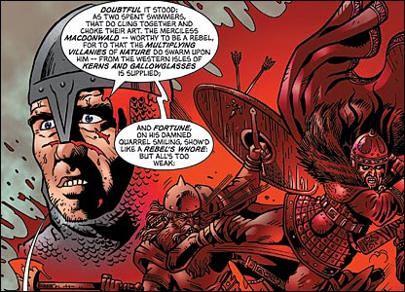
Act One Scene Four

Slide 41
Casting Call
King Duncan
Maplenator
Dr. Lamberticus
Prince Malcolm
Dr. Liz
Dr. Philletites
Macbeth (“thane” of Glamis)
Dr. Brewer
Dr. Webbronatron
Banquo (Bro of Macbeth)
Mastah Chi
Don Dunn
Ross
Dr. Ambrister
Major Silveria
Angus
Scotticus Rex
Dr. Myopia

Slide 42
A trumpet fanfare sounds. KING DUNCAN,LENNOX, MALCOLM, DONALBAIN, and their attendants enter.
DUNCAN
Is execution done on Cawdor? Are not
Those in commission yet returned?
MALCOLM
My liege,
They are not yet come back. But I have spoke
With one that saw him die, who did report
That very frankly he confessed his treasons,
Implored your highness' pardon, and set forth
A deep repentance. Nothing in his life
Became him like the leaving it. He died
As one that had been studied in his death
To throw away the dearest thing he owed
As ’twere a careless trifle.
A trumpet fanfare sounds. KING DUNCAN,LENNOX, MALCOLM, DONALBAIN, and their attendants enter.
DUNCAN
Has the former thane of Cawdor been executed yet? Haven’t the people in charge of that come back?
MALCOLM
My king, they haven’t come back yet. But I spoke with someone who saw Cawdor die, and he said that Cawdor openly confessed his treasons, begged your highness’s forgiveness, and repented deeply. He never did anything in his whole life that looked as good as the way he died. He died like someone who had practiced how to toss away his most cherished possession as if it were a worthless a piece of garbage.

Slide 43
DUNCAN
There’s no art
To find the mind’s construction in the face.
He was a gentleman on whom I built
An absolute trust.
MACBETH, BANQUO, ROSS, and ANGUS enter.
(to MACBETH) O worthiest cousin,
The sin of my ingratitude even now
Was heavy on me. Thou art so far before
That swiftest wing of recompense is slow
To overtake thee. Would thou hadst less deserved,
That the proportion both of thanks and payment
Might have been mine! Only I have left to say,
More is thy due than more than all can pay.
DUNCAN
There’s no way to read a man’s mind by looking at his face. I trusted Cawdor completely.
MACBETH, BANQUO, ROSS, and ANGUS enter.
(to MACBETH) O worthiest cousin,
The sin of my ingratitude even now
Was heavy on me. Thou art so far before
That swiftest wing of recompense is slow
To overtake thee. Would thou hadst less deserved,
That the proportion both of thanks and payment
Might have been mine! Only I have left to say,
More is thy due than more than all can pay.

Slide 44
MACBETH
The service and the loyalty I owe
In doing it pays itself. Your highness' part
Is to receive our duties, and our duties
Are to your throne and state children and servants,
Which do but what they should, by doing everything
Safe toward your love and honor.
MACBETH
The opportunity to serve you is its own reward. Your only duty, your highness, is to accept what we owe you. Our duty to you and your state is like the duty of children to their father or servants to their master. By doing everything we can to protect you, we’re only doing what we should.

Slide 45
DUNCAN
Welcome hither.
I have begun to plant thee, and will labor
To make thee full of growing. (to BANQUO) Noble Banquo,
That hast no less deserved, nor must be known
No less to have done so, let me infold thee
And hold thee to my heart.
BANQUO
There, if I grow,
The harvest is your own.
DUNCAN
You are welcome here. By making you thane of Cawdor, I have planted the seeds of a great career for you, and I will make sure they grow. (to BANQUO) Noble Banquo, you deserve no less than Macbeth, and everyone should know it. Let me bring you close to me and give you the benefit of my love and good will.
BANQUO
Then if I accomplish anything great, it will be a credit to you.

Slide 46
DUNCAN
My plenteous joys,
Wanton in fullness, seek to hide themselves
In drops of sorrow. Sons, kinsmen, thanes,
And you whose places are the nearest, know
We will establish our estate upon
Our eldest, Malcolm, whom we name hereafter
The prince of Cumberland; which honor must
Not unaccompanied invest him only,
But signs of nobleness, like stars, shall shine
On all deservers. (to MACBETH) From hence to Inverness,
And bind us further to you.
DUNCAN
My joy is so overwhelming it brings tears to my eyes. My sons, relatives, lords, and all those closest to me, I want you to witness that I will bestow my kingdom on my eldest son, Malcolm. Today I name him the prince of Cumberland. But Malcolm isn’t going to be alone in receiving honors—titles of nobility will shine like stars on all of you who deserve them. (to MACBETH) And now, let’s go to your castle at Inverness, where I will become even more obliged to you because of your hospitality.

Slide 47
MACBETH
The rest is labor which is not used for you:
I’ll be myself the harbinger and make joyful
The hearing of my wife with your approach.
So humbly take my leave.
DUNCAN
My worthy Cawdor!
MACBETH
(aside) The prince of Cumberland! That is a step
On which I must fall down, or else o'erleap,
For in my way it lies. Stars, hide your fires;
Let not light see my black and deep desires.
The eye wink at the hand, yet let that be
Which the eye fears, when it is done, to see.
MACBETH exits.
MACBETH
I’m not happy unless I can be working for you. I will go ahead and bring my wife the good news that you are coming. With that, I’ll be off.
DUNCAN
My worthy Cawdor!
MACBETH
(to himself) Malcolm is now the prince of Cumberland! To become king myself, I’m either going to have to step over him or give up, because he’s in my way. Stars, hide your light so no one can see the terrible desires within me. I won’t let my eye look at what my hand is doing, but in the end I’m still going to do that thing I’d be horrified to see.
MACBETH exits.

Slide 48
DUNCAN
True, worthy Banquo. He is full so valiant,
And in his commendations I am fed;
It is a banquet to me.—Let’s after him,
Whose care is gone before to bid us welcome:
It is a peerless kinsman.
Flourish. Exeunt
DUNCAN
(to BANQUO, in the middle of a conversation we haven’t heard) You’re right, Banquo. Macbeth is every bit as valiant as you say, and I am satisfied with these praises of him. Let’s follow after him, now that he has gone ahead to prepare our welcome. He is a man without equal.
Trumpet fanfare. They exit.

Slide 49
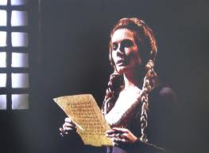
Act One Scene Five

Slide 50
Casting Call
Lady Macbeth (possibly the coldest, most conniving, character Shakespeare ever wrote)
Dr. Ambrister
Dr. Phillipines
Servant (the opposite of a king)
Dr. Brown
Major Silveria
Macbeth (now has cold feet)
Mastah Chi
Dr. Webbinar

Slide 51
LADY MACBETH enters, reading a letter.
LADY MACBETH
(reading) “They met me in the day of success, and I have learned by the perfectest report they have more in them than mortal knowledge. When I burned in desire to question them further, they made themselves air, into which they vanished. Whiles I stood rapt in the wonder of it came missives from the king, who all-hailed me 'Thane of Cawdor,' by which title, before, these weird sisters saluted me, and referred me to the coming on of time with 'Hail, king that shalt be!' This have I thought good to deliver thee, my dearest partner of greatness, that thou might’st not lose the dues of rejoicing, by being ignorant of what greatness is promised thee. Lay it to thy heart, and farewell.”
LADY MACBETH enters, reading a letter.
LADY MACBETH
“The witches met me on the day of my victory in battle, and I have since learned that they have supernatural knowledge. When I tried desperately to question them further, they vanished into thin air. While I stood spellbound, messengers from the king arrived and greeted me as the thane of Cawdor, which is precisely how the weird sisters had saluted me before calling me ’the future king!' I thought I should tell you this news, my dearest partner in greatness, so that you could rejoice along with me about the greatness that is promised to us. Keep it secret, and farewell.”

Slide 52
LADY MACBETH
Glamis thou art, and Cawdor; and shalt be
What thou art promised. Yet do I fear thy nature;
It is too full o' th' milk of human kindness
To catch the nearest way: thou wouldst be great,
Art not without ambition, but without
The illness should attend it. What thou wouldst highly,
That wouldst thou holily; wouldst not play false,
And yet wouldst wrongly win. Thou'ld’st have, great Glamis,
That which cries, “Thus thou must do,” if thou have it,
And that which rather thou dost fear to do,
Than wishest should be undone. Hie thee hither,
That I may pour my spirits in thine ear
And chastise with the valor of my tongue
All that impedes thee from the golden round,
Which fate and metaphysical aid doth seem
To have thee crowned withal.
LADY MACBETH
(she looks up from the letter) You are thane of Glamis and Cawdor, and you’re going to be king, just like you were promised. But I worry about whether or not you have what it takes to seize the crown. You are too full of the milk of human kindness to strike aggressively at your first opportunity. You want to be powerful, and you don’t lack ambition, but you don’t have the mean streak that these things call for. The things you want to do, you want to do like a good man. You don’t want to cheat, yet you want what doesn’t belong to you. There’s something you want, but you’re afraid to do what you need to do to get it. You want it to be done for you. Hurry home so I can persuade you and talk you out of whatever’s keeping you from going after the crown. After all, fate and witchcraft both seem to want you to be king.

Slide 53
A SERVANT enters.
LADY MACBETH
What is your tidings?
SERVANT
The king comes here tonight.
LADY MACBETH
Thou 'rt mad to say it.
Is not thy master with him, who, were ’t so,
Would have informed for preparation?
A SERVANT enters.
LADY MACBETH
What news do you bring?
SERVANT
The king is coming here tonight.
LADY MACBETH
You must be crazy to say that! Isn’t Macbeth with the king, and wouldn’t Macbeth have told me in advance so I could prepare, if the king were really coming?

Slide 54
SERVANT
So please you, it is true: our thane is coming.
One of my fellows had the speed of him,
Who, almost dead for breath, had scarcely more
Than would make up his message.
LADY MACBETH
Give him tending.
He brings great news.
The SERVANT exits.
SERVANT
I’m sorry, but it’s the truth. Macbeth is coming. He sent a messenger ahead of him who arrived here so out of breath that he could barely speak his message.
LADY MACBETH
Take good care of him. He brings great news.
The SERVANT exits.

Slide 55
LADY MACBETH
The raven himself is hoarse
That croaks the fatal entrance of Duncan
Under my battlements. Come, you spirits
That tend on mortal thoughts, unsex me here,
And fill me from the crown to the toe top-full
Of direst cruelty. Make thick my blood.
Stop up the access and passage to remorse,
That no compunctious visitings of nature
Shake my fell purpose, nor keep peace between
The effect and it! Come to my woman’s breasts,
And take my milk for gall, you murd'ring ministers,
Wherever in your sightless substances
You wait on nature’s mischief. Come, thick night,
And pall thee in the dunnest smoke of hell,
That my keen knife see not the wound it makes,
Nor heaven peep through the blanket of the dark
To cry “Hold, hold!”
LADY MACBETH
So the messenger is short of breath, like a hoarse raven, as he announces Duncan’s entrance into my fortress, where he will die. Come, you spirits that asist murderous thoughts, make me less like a woman and more like a man, and fill me from head to toe with deadly cruelty! Thicken my blood and clog up my veins so I won’t feel remorse, so that no human compassion can stop my evil plan or prevent me from accomplishing it! Come to my female breast and turn my mother’s milk into poisonous acid, you murdering demons, wherever you hide, invisible and waiting to do evil! Come, thick night, and cover the world in the darkest smoke of hell, so that my sharp knife can’t see the wound it cuts open, and so heaven can’t peep through the darkness and cry, “No! Stop!”

Slide 56
MACBETH enters.
LADY MACBETH
Great Glamis, worthy Cawdor,
Greater than both, by the all-hail hereafter,
Thy letters have transported me beyond
This ignorant present, and I feel now
The future in the instant.
MACBETH
My dearest love,
Duncan comes here tonight.
MACBETH enters.
LADY MACBETH
Great thane of Glamis! Worthy thane of Cawdor! You’ll soon be greater than both those titles, once you become king! Your letter has transported me from the present moment, when who knows what will happen, and has made me feel like the future is already here.
MACBETH
My dearest love, Duncan is coming here tonight.

Slide 57
LADY MACBETH
And when goes hence?
MACBETH
Tomorrow, as he purposes.
LADY MACBETH
O, never
Shall sun that morrow see!
Your face, my thane, is as a book where men
May read strange matters. To beguile the time,
Look like the time. Bear welcome in your eye,
Your hand, your tongue. Look like th' innocent flower,
But be the serpent under ’t. He that’s coming
Must be provided for; and you shall put
This night’s great business into my dispatch,
Which shall to all our nights and days to come
Give solely sovereign sway and masterdom.
LADY MACBETH
And when is he leaving?
MACBETH
He plans to leave tomorrow.
LADY MACBETH
That day will never come. Your face betrays strange feelings, my lord, and people will be able to read it like a book. In order to deceive them, you must appear the way they expect you to look. Greet the king with a welcoming expression in your eyes, your hands, and your words. You should look like an innocent flower, but be like the snake that hides underneath the flower. The king is coming, and he’s got to be taken care of. Let me handle tonight’s preparations, because tonight will change every night and day for the rest of our lives.

Slide 58
MACBETH
We will speak further.
LADY MACBETH
Only look up clear.
To alter favor ever is to fear.
Leave all the rest to me.
Exeunt
MACBETH
We will speak about this further.
LADY MACBETH
You should project a peaceful mood, because if you look troubled, you will arouse suspicion. Leave all the rest to me.
They exit.

Slide 59
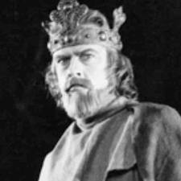
Act One Scene Six

Slide 60
Casting Call
Speaking Parts
DUNCAN (The king, not the brightest bulb)
Dr. Brown
Major Silveria
BANQUO (Macbeth’s Brotato)
Mastah Chi
Don Dunn
LADY MACBETH (Macbeth’s lady, pretty much Satan)
Dr. Armbrister
Dr. Phillipi The Land of the Ancient Tortoises
In the scene, but doesn’t have a talking part
MALCOLM (Duncan’s son)
DONALBAIN (Duncan’s other son, the Meg of the family)
LENNOX (Not the operating system, a servant to Duncan)
ROSS (Still a Thane)
ANGUS (Still not a hamburger)
MACDUFF (a good dude, who detects Macbeth’s Bull$#$#)

Slide 61
The stage is lit by torches. Hautboys play. DUNCAN enters, together with MALCOLM,DONALBAIN, BANQUO, LENNOX,
MACDUFF,ROSS, ANGUS, and their attendants.
DUNCAN
This castle hath a pleasant seat. The air
Nimbly and sweetly recommends itself
Unto our gentle senses.
The stage is lit by torches. Hautboys play. DUNCAN enters, together with MALCOLM,DONALBAIN, BANQUO, LENNOX,
MACDUFF,ROSS, ANGUS, and their attendants.
DUNCAN
This castle is in a pleasant place. The air is sweet and appeals to my refined senses.

Slide 62
BANQUO
This guest of summer,
The temple-haunting martlet, does approve,
By his loved mansionry, that the heaven’s breath
Smells wooingly here. No jutty, frieze,
Buttress, nor coign of vantage, but this bird
Hath made his pendant bed and procreant cradle.
Where they most breed and haunt, I have observed,
The air is delicate.
BANQUO
The fact that this summer bird, the house martin, builds his nests here proves how inviting the breezes are. There isn’t a single protrusion in the castle walls where these birds haven’t built their hanging nests to sleep and breed. I’ve noticed that they always like to settle and mate where the air is the nicest.

Slide 63
LADY MACBETH enters.
DUNCAN
See, see, our honored hostess!
The love that follows us sometime is our trouble,
Which still we thank as love. Herein I teach you
How you shall bid God 'ild us for your pains,
And thank us for your trouble.
LADY MACBETH
All our service,
In every point twice done and then done double,
Were poor and single business to contend
Against those honors deep and broad wherewith
Your majesty loads our house. For those of old,
And the late dignities heaped up to them,
We rest your hermits.
LADY MACBETH enters.
DUNCAN
Look, here comes our honored hostess! Sometimes the love my subjects bring me is inconvenient, but I still accept it as love. In doing so, I’m teaching you to thank me for the incovenience I’m causing you by being here, because it comes from my love to you.
LADY MACBETH
Everything we’re doing for you, even if it were doubled and then doubled again, is nothing compared to the honors you have brought to our family. We gladly welcome you as our guests, with gratitude for both the honors you’ve given us before and the new honors you’ve just given us.

Slide 64
DUNCAN
Where’s the thane of Cawdor?
We coursed him at the heels and had a purpose
To be his purveyor; but he rides well,
And his great love, sharp as his spur, hath holp him
To his home before us. Fair and noble hostess,
We are your guest tonight.
LADY MACBETH
Your servants ever
Have theirs, themselves, and what is theirs in compt,
To make their audit at your highness' pleasure,
Still to return your own.
DUNCAN
Where is Macbeth, the thane of Cawdor? We followed closely after him. I hoped to arrive here before him, but he rides swiftly. And his great love, which is as sharp as his spur, helped him beat us here. Fair and noble hostess, we are your guests tonight.
LADY MACBETH
We are your servants, your highness, and as always our house and everything in it is at your disposal, for after all, we keep it in your trust and we’re glad to give you back what’s yours.

Slide 65
DUNCAN
Give me your hand.
Conduct me to mine host. We love him highly
And shall continue our graces towards him.
By your leave, hostess.
Exeunt
DUNCAN
Give me your hand. Bring me to my host, Macbeth. I love him dearly, and I shall continue to favor him. Whenever you’re ready, hostess.
They all exit.

Slide 66
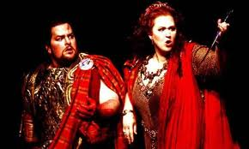
Act One Scene Seven

Slide 67
Casting Call
Lady Macbeth (at this point, pretty obviously evil)
Dr. Liz
Dr. The Oracle at Phelphi
Macbeth (really isn’t sure about the whole, murder the king plan)
Dr. Warrick
Dr. Webbed feet allow ducks to propel themselves through water swiftly

Slide 68
Hautboys play. The stage is lit by torches. A butler enters, and various servants carry utensils and dishes of food across the stage. Then MACBETH enters.
MACBETH
If it were done when ’tis done, then ’twere well
It were done quickly. If the assassination
Could trammel up the consequence, and catch
With his surcease success; that but this blow
Might be the be-all and the end-all here,
But here, upon this bank and shoal of time,
We’d jump the life to come. But in these cases
We still have judgment here, that we but teach
Bloody instructions, which, being taught, return
To plague th' inventor:
Hautboys play. The stage is lit by torches. A butler enters, and various servants carry utensils and dishes of food across the stage. Then MACBETH enters.
MACBETH
If this business would really be finished when I did the deed, then it would be best to get it over with quickly. If the assassination of the king could work like a net, sweeping up everything and preventing any consequences, then the murder would be the be-all and end-all of the whole affair, and I would gladly put my soul and the afterlife at risk to do it. But for crimes like these there are still punishments in this world. By committing violent crimes we only teach other people to commit violence, and the violence of our students will come back to plague us teachers.

Slide 69
MACBETH
this even-handed justice
Commends the ingredients of our poisoned chalice
To our own lips. He’s here in double trust:
First, as I am his kinsman and his subject,
Strong both against the deed; then, as his host,
Who should against his murderer shut the door,
Not bear the knife myself. Besides, this Duncan
Hath borne his faculties so meek, hath been
So clear in his great office, that his virtues
Will plead like angels, trumpet-tongued, against
The deep damnation of his taking-off;
And pity, like a naked newborn babe,
Striding the blast, or heaven’s cherubim, horsed
Upon the sightless couriers of the air,
Shall blow the horrid deed in every eye,
That tears shall drown the wind. I have no spur
To prick the sides of my intent, but only
Vaulting ambition, which o'erleaps itself
And falls on th' other.
MACBETH
Justice, being equal to everyone, forces us to drink from the poisoned cup that we serve to others. The king trusts me in two ways. First of all, I am his kinsman and his subject, so I should always try to protect him. Second, I am his host, so I should be closing the door in his murderer’s face, not trying to murder him myself. Besides, Duncan has been such a humble leader, so free of corruption, that his virtuous legacy will speak for him when he dies, as if angels were playing trumpets against the injustice of his murder. Pity, like an innocent newborn baby, will ride the wind with winged angels on invisible horses through the air to spread news of the horrible deed to everyone everywhere. People will shed a flood of tears that will drown the wind like a horrible downpour of rain. I can’t spur myself to action. The only thing motivating me is ambition, which makes people rush ahead of themselves toward disaster.

Slide 70
LADY MACBETH enters.
MACBETH
How now! What news?
LADY MACBETH
He has almost supped. Why have you left the chamber?
MACBETH
Hath he asked for me?
LADY MACBETH
Know you not he has?
LADY MACBETH enters.
MACBETH
What news do you have?
LADY MACBETH
He has almost finished dinner. Why did you leave the dining room?
MACBETH
Has he asked for me?
LADY MACBETH
Don’t you know he has?

Slide 71
MACBETH
We will proceed no further in this business.
He hath honored me of late, and I have bought
Golden opinions from all sorts of people,
Which would be worn now in their newest gloss,
Not cast aside so soon.
LADY MACBETH
Was the hope drunk
Wherein you dressed yourself? Hath it slept since?
And wakes it now, to look so green and pale
At what it did so freely? From this time
Such I account thy love. Art thou afeard
To be the same in thine own act and valor
As thou art in desire? Wouldst thou have that
Which thou esteem’st the ornament of life,
And live a coward in thine own esteem,
Letting “I dare not” wait upon “I would, ”
Like the poor cat i' th' adage?
MACBETH
We can’t go on with this plan. The king has just honored me, and I have earned the good opinion of all sorts of people. I want to enjoy these honors while the feeling is fresh and not throw them away so soon.
LADY MACBETH
Were you drunk when you seemed so hopeful before? Have you gone to sleep and woken up green and pale in fear of this idea? From now on this is what I’ll think of your love. Are you afraid to act the way you desire? Will you take the crown you want so badly, or will you live as a coward, always saying “I can’t” after you say “I want to”? You’re like the poor cat in the old story.

Slide 72
MACBETH
Prithee, peace:
I dare do all that may become a man;
Who dares do more is none.
LADY MACBETH
What beast was ’t, then,
That made you break this enterprise to me?
When you durst do it, then you were a man;
And to be more than what you were, you would
Be so much more the man. Nor time nor place
Did then adhere, and yet you would make both.
They have made themselves, and that their fitness now
Does unmake you. I have given suck, and know
How tender ’tis to love the babe that milks me.
I would, while it was smiling in my face,
Have plucked my nipple from his boneless gums
And dashed the brains out, had I so sworn as you
Have done to this.
MACBETH
Please, stop! I dare to do only what is proper for a man to do. He who dares to do more is not a man at all.
LADY MACBETH
If you weren’t a man, then what kind of animal were you when you first told me you wanted to do this? When you dared to do it, that’s when you were a man. And if you go one step further by doing what you dared to do before, you’ll be that much more the man. The time and place weren’t right before, but you would have gone ahead with the murder anyhow. Now the time and place are just right, but they’re almost too good for you. I have suckled a baby, and I know how sweet it is to love the baby at my breast. But even as the baby was smiling up at me, I would have plucked my nipple out of its mouth and smashed its brains out against a wall if I had sworn to do that the same way you have sworn to do this.

Slide 73
MACBETH
If we should fail?
LADY MACBETH
We fail?
But screw your courage to the sticking-place,
And we’ll not fail. When Duncan is asleep—
Whereto the rather shall his day’s hard journey
Soundly invite him—his two chamberlains
Will I with wine and wassail so convince
That memory, the warder of the brain,
Shall be a fume, and the receipt of reason
A limbeck only: when in swinish sleep
Their drenchèd natures lie as in a death,
What cannot you and I perform upon
The unguarded Duncan? What not put upon
His spongy officers, who shall bear the guilt
Of our great quell?
MACBETH
But if we fail—
LADY MACBETH
We, fail? If you get your courage up, we can’t fail. When Duncan is asleep—the day’s hard journey has definitely made him tired—I’ll get his two servants so drunk that their memory will go up in smoke through the chimneys of their brains. When they lie asleep like pigs, so drunk they’ll be dead to the world, what won’t you and I be able to do to the unguarded Duncan? And whatever we do, we can lay all the blame on the drunken servants.

Slide 74
MACBETH
Bring forth men-children only,
For thy undaunted mettle should compose
Nothing but males. Will it not be received,
When we have marked with blood those sleepy two
Of his own chamber and used their very daggers,
That they have done ’t?
LADY MACBETH
Who dares receive it other,
As we shall make our griefs and clamor roar
Upon his death?
MACBETH
May you only give birth to male children, because your fearless spirit should create nothing that isn’t masculine. Once we have covered the two servants with blood, and used their daggers to kill, won’t people believe that they were the culprits?
LADY MACBETH
Who could think it happened any other way? We’ll be grieving loudly when we hear that Duncan has died.

Slide 75
MACBETH
I am settled, and bend up
Each corporal agent to this terrible feat.
Away, and mock the time with fairest show.
False face must hide what the false heart doth know.
Exeunt
MACBETH
Now I’m decided, and I will exert every muscle in my body to commit this crime. Go now, and pretend to be a friendly hostess. Hide with a false pleasant face what you know in your false, evil heart.
They exit.

