Slide 1
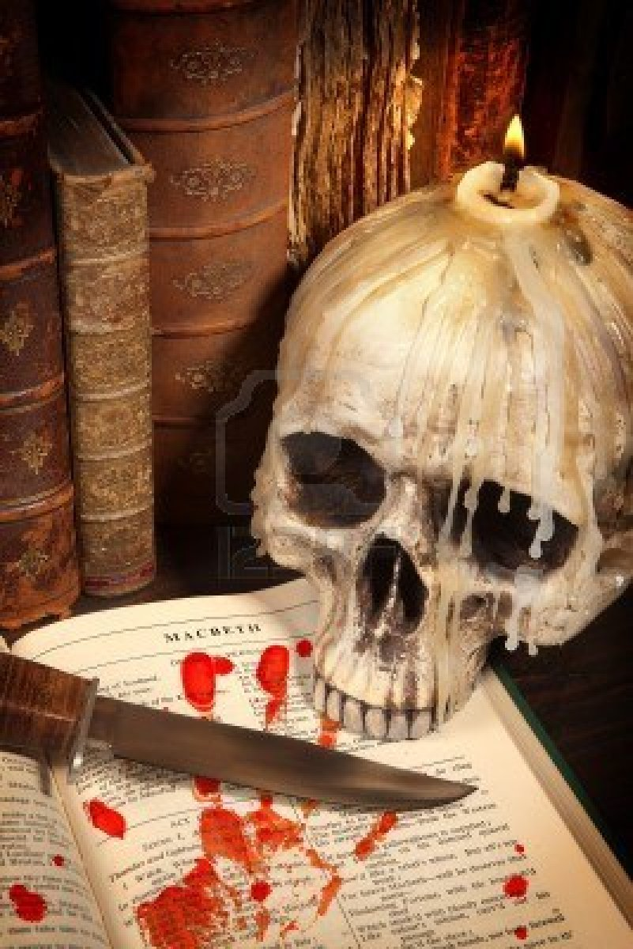
The Tragedy of Macbeth

Slide 2
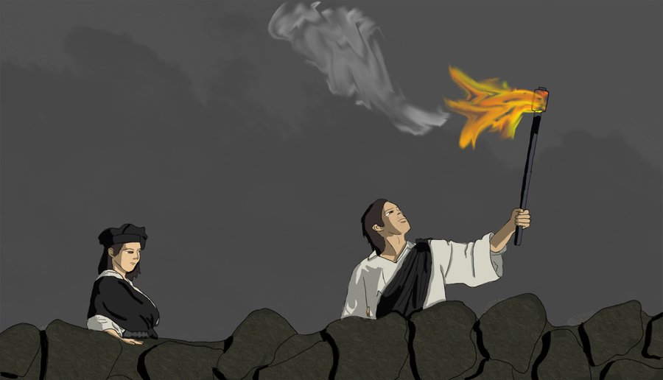
Act Two Scene One

Slide 3
Casting Call
Macbeth (THE MAYN)
Dr. Armbrister
Dr. Thurman
Banquo (Macbeth’s G)
Dr. Brown
Don Dunn
Fleance (Banquo’s kid)
Dr. Liz
Major Silveria

Slide 4
Enter BANQUO, and FLEANCE, with a torch before him
BANQUO
How goes the night, boy?
FLEANCE
The moon is down. I have not heard the clock.
BANQUO
And she goes down at twelve.
BANQUO enters with FLEANCE, who lights the way with a torch.
BANQUO
How’s the night going, boy?
FLEANCE
The moon has set. The clock hasn’t struck yet.
BANQUO
The moon sets at twelve, right?

Slide 5
FLEANCE
I take ’t ’tis later, sir.
BANQUO
Hold, take my sword. There’s husbandry in heaven;
Their candles are all out. Take thee that too.
A heavy summons lies like lead upon me,
And yet I would not sleep. Merciful powers,
Restrain in me the cursèd thoughts that nature
Gives way to in repose.
Enter MACBETH and a SERVANT with a torch
FLEANCE
I think it’s later than that, sir.
BANQUO
Here, take my sword. The heavens are being stingy with their light. Take this, too. I’m tired and feeling heavy, but I can’t sleep. Merciful powers, keep away the nightmares that plague me when I rest!
MACBETH enters with a SERVANT, who carries a torch.

Slide 6
BANQUO
Give me my sword. Who’s there?
MACBETH
A friend.
BANQUO
What, sir, not yet at rest? The king’s a-bed.
He hath been in unusual pleasure, and
Sent forth great largess to your offices.
This diamond he greets your wife withal,
By the name of most kind hostess, and shut up
In measureless content.
BANQUO
Give me my sword. Who’s there?
MACBETH
A friend.
BANQUO
You’re not asleep yet, sir? The king’s in bed. He’s been in an unusually good mood and has granted many gifts to your household and servants. This diamond is a present from him to your wife for her boundless hospitality. (he hands MACBETH a diamond)

Slide 7
MACBETH
Being unprepared,
Our will became the servant to defect,
Which else should free have wrought.
BANQUO
All’s well.
I dreamt last night of the three weird sisters:
To you they have showed some truth.
MACBETH
I think not of them.
Yet, when we can entreat an hour to serve,
We would spend it in some words upon that business,
If you would grant the time.
MACBETH
Because we were unprepared for the king’s visit, we weren’t able to entertain him as well as we would have wanted to.
BANQUO
Everything’s OK. I had a dream last night about the three witches. At least part of what they said about you was true.
MACBETH
I don’t think about them now. But when we have an hour to spare we can talk more about it, if you’re willing.

Slide 8
BANQUO
At your kind’st leisure.
MACBETH
If you shall cleave to my consent, when ’tis,
It shall make honor for you.
BANQUO
So I lose none
In seeking to augment it, but still keep
My bosom franchised and allegiance clear,
I shall be counselled.
BANQUO
Whenever you like.
MACBETH
If you stick with me, when the time comes, there will be something in it for you.
BANQUO
I’ll do whatever you say, as long as I can do it with a clear conscience.

Slide 9
MACBETH
Good repose the while!
BANQUO
Thanks, sir: the like to you!
Exeunt BANQUO and
FLEANCE
MACBETH
(to the SERVANT) Go bid thy mistress, when my drink is ready,
She strike upon the bell. Get thee to bed.
MACBETH
Rest easy in the meantime.
BANQUO
Thank you, sir. You do the same.
BANQUO and FLEANCE exit.
MACBETH
(to the SERVANT) Go and tell your mistress to strike the bell when my drink is ready. Get yourself to bed.

Slide 10
Exit SERVANT
MACBETH
Is this a dagger which I see before me,
The handle toward my hand? Come, let me clutch thee.
I have thee not, and yet I see thee still.
Art thou not, fatal vision, sensible
To feeling as to sight? Or art thou but
A dagger of the mind, a false creation,
Proceeding from the heat-oppressèd brain?
I see thee yet, in form as palpable
As this which now I draw.
The SERVANT exits.
MACBETH
Is this a dagger I see in front of me, with its handle pointing toward my hand? (to the dagger) Come, let me hold you. (he grabs at the air in front of him without touching anything) I don’t have you but I can still see you. Fateful apparition, isn’t it possible to touch you as well as see you? Or are you nothing more than a dagger created by the mind, a hallucination from my fevered brain? I can still see you, and you look as real as this other dagger that I’m pulling out now.

Slide 11
MACBETH
Thou marshall’st me the way that I was going,
And such an instrument I was to use.
Mine eyes are made the fools o' th' other senses,
Or else worth all the rest. I see thee still,
And on thy blade and dudgeon gouts of blood,
Which was not so before.
MACBETH
(he draws a dagger) You’re leading me toward the place I was going already, and I was planning to use a weapon just like you. My eyesight must either be the one sense that’s not working, or else it’s the only one that’s working right. I can still see you, and I see blood splotches on your blade and handle that weren’t there before.

Slide 12
MACBETH
There’s no such thing.
It is the bloody business which informs
Thus to mine eyes. Now o'er the one half-world
Nature seems dead, and wicked dreams abuse
The curtained sleep. Witchcraft celebrates
Pale Hecate’s offerings, and withered murder,
Alarumed by his sentinel, the wolf,
Whose howl’s his watch, thus with his stealthy pace,
With Tarquin’s ravishing strides, towards his design
Moves like a ghost.
MACBETH
There’s no dagger here. It’s the murder I’m about to do that’s making me think I see one. Now half the world is asleep and being deceived by evil nightmares. Witches are offering sacrifices to their goddess Hecate. Old man murder, having been roused by the howls of his wolf, walks silently to his destination, moving like Tarquin, as quiet as a ghost.

Slide 13
MACBETH
Thou sure and firm-set earth,
Hear not my steps, which way they walk, for fear
Thy very stones prate of my whereabout,
And take the present horror from the time,
Which now suits with it. Whiles I threat, he lives.
Words to the heat of deeds too cold breath gives.
MACBETH
(speaking to the ground) Hard ground, don’t listen to the direction of my steps. I don’t want you to echo back where I am and break the terrible stillness of this moment, a silence that is so appropriate for what I’m about to do. While I stay here talking, Duncan lives. The more I talk, the more my courage cools.

Slide 14
A bell rings
MACBETH
I go, and it is done. The bell invites me.
Hear it not, Duncan, for it is a knell
That summons thee to heaven or to hell.
Exit
A bell rings
MACBETH
I’m going now. The murder is as good as done. The bell is telling me to do it. Don’t listen to the bell, Duncan, because it summons you either to heaven or to hell.
MACBETH exits.

Slide 15
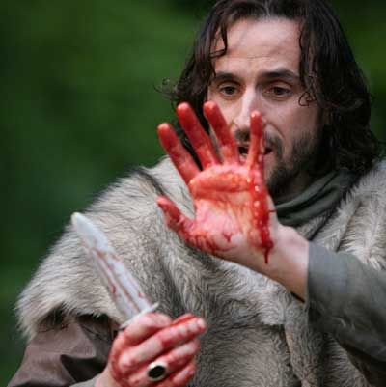
Act Two Scene Two

Slide 16
Casting Call
Lady Macbeth (pretty much lady SATAN!)
Dr. Armbrister
Dr. Philtrum
Macbeth (THE MAYN)
Dr. Davis
Dr. Webb
Banquo (Macbeth’s G)
Dr. Brown
Don Dunn
Fleance (Banquo’s kid)
Dr. Liz
Major Silveria

Slide 17
Enter LADY MACBETH
LADY MACBETH
That which hath made them drunk hath made me bold.
What hath quenched them hath given me fire.
Hark! Peace! It was the owl that shrieked, the fatal bellman,
Which gives the stern’st good-night. He is about it.
The doors are open, and the surfeited grooms
Do mock their charge with snores. I have drugged their possets,
That death and nature do contend about them,
Whether they live or die.
LADY MACBETH enters.
LADY MACBETH
The alcohol that got the servants drunk has made me bold. The same liquor that quenched their thirst has fired me up. Listen! Quiet! That was the owl that shrieked, with a scary “good night” like the bells they ring before they execute people. Macbeth must be killing the king right now. The doors to Duncan’s chamber are open, and the drunk servants make a mockery of their jobs by snoring instead of protecting the king. I put so many drugs in their drinks that you can’t tell if they’re alive or dead.

Slide 18
MACBETH
(within) Who’s there? What, ho!
LADY MACBETH
Alack, I am afraid they have awaked,
And ’tis not done. Th' attempt and not the deed
Confounds us. Hark! I laid their daggers ready;
He could not miss 'em. Had he not resembled
My father as he slept, I had done ’t.
MACBETH
(from offstage) Who’s there? What is it?
LADY MACBETH
Oh no, I’m afraid the servants woke up, and the murder didn’t happen. For us to attempt murder and not succeed would ruin us. (She hears a noise.) Listen to that! I put the servants' daggers where Macbeth would find them. He couldn’t have missed them. If Duncan hadn’t reminded me of my father when I saw him sleeping, I would have killed him myself.

Slide 19
Enter MACBETH, with bloody daggers
LADY MACBETH
My husband!
MACBETH
I have done the deed. Didst thou not hear a noise?
LADY MACBETH
I heard the owl scream and the crickets cry.
Did not you speak?
MACBETH enters carrying bloody daggers.
LADY MACBETH
My husband!
MACBETH
I have done the deed. Did you hear a noise?
LADY MACBETH
I heard the owl scream and the crickets cry. Didn’t you say something?

Slide 20
MACBETH
When?
LADY MACBETH
Now.
MACBETH
As I descended?
LADY MACBETH
Ay.
MACBETH
Hark! Who lies i' th' second chamber?
MACBETH
When?
LADY MACBETH
Just now.
MACBETH
As I came down?
LADY MACBETH
Yes.
MACBETH
Listen! Who’s sleeping in the second chamber?

Slide 21
LADY MACBETH
Donalbain.
MACBETH
(looking at his hands) This is a sorry sight.
LADY MACBETH
A foolish thought, to say a sorry sight.
MACBETH
There’s one did laugh in ’s sleep, and one cried. “Murder!”
That they did wake each other. I stood and heard them.
But they did say their prayers, and addressed them
Again to sleep.
LADY MACBETH
Donalbain.
MACBETH
(looking at his bloody hands) This is a sorry sight.
LADY MACBETH
That’s a stupid thing to say.
MACBETH
One of the servants laughed in his sleep, and one cried, “Murder!” and they woke each other up. I stood and listened to them, but then they said their prayers and went back to sleep.

Slide 22
LADY MACBETH
There are two lodged together.
MACBETH
One cried, “God bless us!” and “Amen” the other,
As they had seen me with these hangman’s hands.
List'ning their fear I could not say “Amen,”
When they did say “God bless us!”
LADY MACBETH
Consider it not so deeply.
LADY MACBETH
Malcolm and Donalbain are asleep in the same room.
MACBETH
One servant cried, “God bless us!” and the other replied, “Amen,” as if they had seen my bloody hands. Listening to their frightened voices, I couldn’t reply “Amen” when they said “God bless us!”
LADY MACBETH
Don’t think about it so much.

Slide 23
MACBETH
But wherefore could not I pronounce “Amen”?
I had most need of blessing, and “Amen”
Stuck in my throat.
LADY MACBETH
These deeds must not be thought
After these ways. So, it will make us mad.
MACBETH
Methought I heard a voice cry, “Sleep no more!
Macbeth does murder sleep”—the innocent sleep,
Sleep that knits up the raveled sleave of care,
The death of each day’s life, sore labor’s bath,
Balm of hurt minds, great nature’s second course,
Chief nourisher in life’s feast.
MACBETH
But why couldn’t I say “Amen”? I desperately needed God’s blessing, but the word “Amen” stuck in my throat.
LADY MACBETH
We can’t think that way about what we did. If we do, it’ll drive us crazy.
MACBETH
I thought I heard a voice cry, “Sleep no more! Macbeth is murdering sleep.” Innocent sleep. Sleep that soothes away all our worries. Sleep that puts each day to rest. Sleep that relieves the weary laborer and heals hurt minds. Sleep, the main course in life’s feast, and the most nourishing.

Slide 24
LADY MACBETH
What do you mean?
MACBETH
Still it cried, “Sleep no more!” to all the house.
“Glamis hath murdered sleep, and therefore Cawdor
Shall sleep no more. Macbeth shall sleep no more.”
LADY MACBETH
What are you talking about?
MACBETH
The voice kept crying, “Sleep no more!” to everyone in the house. “Macbeth has murdered sleep, and therefore Macbeth will sleep no more.”

Slide 25
LADY MACBETH
Who was it that thus cried? Why, worthy thane,
You do unbend your noble strength to think
So brainsickly of things. Go get some water,
And wash this filthy witness from your hand.
Why did you bring these daggers from the place?
They must lie there. Go carry them and smear
The sleepy grooms with blood.
LADY MACBETH
Who said that? Why, my worthy lord, you let yourself become weak when you think about things in this cowardly way. Go get some water and wash this bloody evidence from your hands. Why did you carry these daggers out of the room? They have to stay there. Go take them back and smear the sleeping guards with the blood.

Slide 26
MACBETH
I’ll go no more:
I am afraid to think what I have done;
Look on ’t again I dare not.
LADY MACBETH
Infirm of purpose!
Give me the daggers. The sleeping and the dead
Are but as pictures. 'Tis the eye of childhood
That fears a painted devil. If he do bleed,
I’ll gild the faces of the grooms withal,
For it must seem their guilt.
MACBETH
I can’t go back. I’m afraid even to think about what I’ve done. I can’t stand to look at it again.
LADY MACBETH
Coward! Give me the daggers. Dead and sleeping people can’t hurt you any more than pictures can. Only children are afraid of scary pictures. If Duncan bleeds I’ll paint the servants' faces with his blood. We must make it seem like they’re guilty.

Slide 27
Exit
Knock within
MACBETH
Whence is that knocking?
How is ’t with me when every noise appals me?
What hands are here? Ha! They pluck out mine eyes.
Will all great Neptune’s ocean wash this blood
Clean from my hand? No, this my hand will rather
The multitudinous seas incarnadine,
Making the green one red.
LADY MACBETH exits.
A sound of knocking from offstage.
MACBETH
Where is that knocking coming from? What’s happening to me, that I’m frightened of every noise? (looking at his hands) Whose hands are these? Ha! They’re plucking out my eyes. Will all the water in the ocean wash this blood from my hands? No, instead my hands will stain the seas scarlet, turning the green waters red.

Slide 28
Enter LADY MACBETH
LADY MACBETH
My hands are of your color, but I shame
To wear a heart so white.
Knock within
LADY MACBETH
I hear a knocking
At the south entry. Retire we to our chamber.
A little water clears us of this deed.
How easy is it, then! Your constancy
Hath left you unattended.
LADY MACBETH enters.
LADY MACBETH
My hands are as red as yours, but I would be ashamed if my heart were as pale and weak.
A sound of knocking from offstage.
LADY MACBETH
I hear someone knocking at the south entry. Let’s go back to our bedroom. A little water will wash away the evidence of our guilt. It’s so simple! You’ve lost your resolve.

Slide 29
Knock within
LADY MACBETH
Hark! More knocking.
Get on your nightgown, lest occasion call us
And show us to be watchers. Be not lost
So poorly in your thoughts.
MACBETH
To know my deed, ’twere best not know myself.
Knock within
A sound of knocking from offstage.
LADY MACBETH
Listen! There’s more knocking. Put on your nightgown, in case someone comes and sees that we’re awake. Snap out of your daze.
MACBETH
Rather than have to think about my crime, I’d prefer to be completely unconscious.
A sound of knocking from offstage.

Slide 30
MACBETH
Wake Duncan with thy knocking. I would thou couldst.
Exeunt
MACBETH
Wake Duncan with your knocking. I wish you could!
They exit.

Slide 31
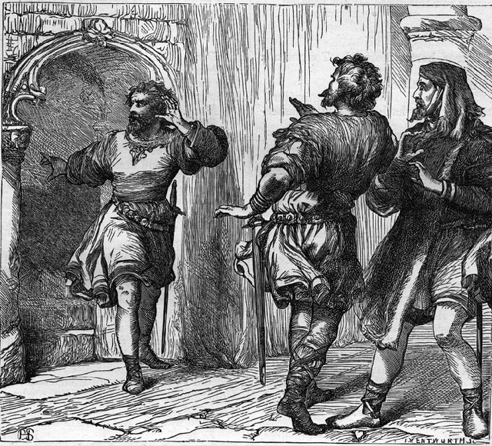
Act Two Scene Three

Slide 32
Casting Call
Porter (a really really freaky door man)
Dr. Maples
Dr. Thurman
Banquo (Mabceth’s buddy)
Don Dunn
Macduff (is capable of detecting Macbeth’s bull##$%)
Dr. Brown
Dr. Lamberghini
Macbeth (a pretty solid liar)
Dr. Davis
Dr. Webb
Lady Macbeth (married a pretty solid liar)
Dr. Brown sister of Beechmont
Dr. Phillips
Lennox (a servant of King Duncan)
Mastah Chi
Dr. Jeffries
Malcolm (the heir to the throne, Duncan’s son the prince)
Dr. Warrick
Major Silveria
Donalbain (Duncan’s other son, not as cool as Malcom, nobody loves him, he knows this, it is kinda sad, the Meg of the family, seriously)
Dr. Buckner8
Dr. Speediest

Slide 33
Enter a PORTER. Knocking within
PORTER
Here’s a knocking indeed! If a man were porter of hell-gate, he should have old turning the key.
Knock within
Knock, knock, knock! Who’s there, i' th' name of Beelzebub? Here’s a farmer that hanged himself on the expectation of plenty. Come in time, have napkins enough about you, here you’ll sweat for ’t.
A sound of knocking from offstage. A PORTER , who is obviously drunk, enters.
PORTER
This is a lot of knocking! Come to think of it, if a man were in charge of opening the gates of hell to let people in, he would have to turn the key a lot.
A sound of knocking from offstage.
Knock, knock, knock! (pretending he’s the gatekeeper in hell) Who’s there, in the devil’s name? Maybe it’s a farmer who killed himself because grain was cheap. (talking to the imaginary farmer) You’re here just in time! I hope you brought some handkerchiefs; you’re going to sweat a lot here.

Slide 34
PORTER
Knock, knock! Who’s there, in th' other devil’s name? Faith, here’s an equivocator that could swear in both the scales against either scale, who committed treason enough for God’s sake, yet could not equivocate to heaven. O, come in, equivocator.
Knock within
Knock, knock, knock! Who’s there? Faith, here’s an English tailor come hither for stealing out of a French hose. Come in, tailor. Here you may roast your goose.
Knock within
PORTER
Knock, knock! Who’s there, in the other devil’s name? Maybe it’s some slick, two-faced con man who lied under oath. But he found out that you can’t lie to God, and now he’s going to hell for perjury. Come on in, con man.
A sound of knocking from offstage.
Knock, knock, knock! Who’s there? Maybe it’s an English tailor who liked to skimp on the fabric for people’s clothes. But now that tight pants are in fashion he can’t get away with it. Come on in, tailor. You can heat your iron up in here.
A sound of knocking from offstage.

Slide 35
PORTER
Knock, knock! Never at quiet. What are you? But this place is too cold for hell. I’ll devil-porter it no further. I had thought to have let in some of all professions that go the primrose way to the everlasting bonfire.
Knock within
Anon, anon! I pray you, remember the porter.
Opens the gate
Enter MACDUFF and LENNOX
PORTER
Knock, knock! Never a moment of peace! Who are you? Ah, this place is too cold to be hell. I won’t pretend to be the devil’s porter anymore. I was going to let someone from every profession into hell.
Knock within
I’m coming, I’m coming! Please, don’t forget to leave me a tip.
The PORTER opens the gate.
MACDUFF and LENNOX
enter.

Slide 36
MACDUFF
Was it so late, friend, ere you went to bed,
That you do lie so late?
PORTER
'Faith sir, we were carousing till the second cock. And drink, sir, is a great provoker of three things.
MACDUFF
What three things does drink especially provoke?
MACDUFF
Did you go to bed so late, my friend, that you’re having a hard time getting up now?
PORTER
That’s right sir, we were drinking until 3 A.M., and drink, sir, makes a man do three things.
MACDUFF
What three things does drink make a man do?

Slide 37
PORTER
Marry, sir, nose-painting, sleep, and urine. Lechery, sir, it provokes and unprovokes. It provokes the desire, but it takes away the performance. Therefore, much drink may be said to be an equivocator with lechery. It makes him, and it mars him; it sets him on, and it takes him off; it persuades him, and disheartens him; makes him stand to and not stand to; in conclusion, equivocates him in a sleep, and, giving him the lie, leaves him.
PORTER
Drinking turns your nose red, it puts you to sleep, and it makes you urinate. Lust it turns on but also turns off. What I mean is, drinking stimulates desire but hinders performance. Therefore, too much drink is like a con artist when it comes to your sex drive. It sets you up for a fall. It gets you up but it keeps you from getting off. It persuades you and discourages you. It gives you an erection but doesn’t let you keep it, if you see what I’m saying. It makes you dream about erotic experiences, but then it leaves you asleep and needing to pee.

Slide 38
MACDUFF
I believe drink gave thee the lie last night.
PORTER
That it did, sir, i' th' very throat on me; but I requited him for his lie, and, I think, being too strong for him, though he took up my legs sometime, yet I made a shift to cast him.
MACDUFF
Is thy master stirring?
Enter MACBETH
MACDUFF
Our knocking has awaked him. Here he comes.
MACDUFF
I believe drink did all of this to you last night.
PORTER
It did, sir. It got me right in the throat. But I got even with drink. I was too strong for it. Although it weakened my legs and made me unsteady, I managed to vomit it out and laid it flat on the ground.
MACDUFF
Is your master awake?
MACBETH enters.
MACDUFF
Our knocking woke him up. Here he comes.

Slide 39
LENNOX
Good morrow, noble sir.
MACBETH
Good morrow, both.
MACDUFF
Is the king stirring, worthy thane?
MACBETH
Not yet.
MACDUFF
He did command me to call timely on him.
I have almost slipped the hour.
MACBETH
I’ll bring you to him.
LENNOX
Good morning, noble sir.
MACBETH
Good morning to both of you.
MACDUFF
Is the king awake, worthy thane?
MACBETH
Not yet.
MACDUFF
He commanded me to wake him up early. I’ve almost missed the time he requested.
MACBETH
I’ll bring you to him.

Slide 40
MACDUFF
I know this is a joyful trouble to you,
But yet ’tis one.
MACBETH
The labor we delight in physics pain.
This is the door.
MACDUFF
I’ll make so bold to call,
For ’tis my limited service.
Exit MACDUFF
MACDUFF
I know the burden of hosting him is both an honor and a trouble, but that doesn’t mean it’s not a trouble just the same.
MACBETH
The work we enjoy is not really work. This is the door.
MACDUFF
I’ll wake him, because that’s my job.
MACDUFF exits.

Slide 41
LENNOX
Goes the king hence today?
MACBETH
He does. He did appoint so.
LENNOX
The night has been unruly. Where we lay,
Our chimneys were blown down and, as they say,
Lamentings heard i' th' air, strange screams of death,
And prophesying with accents terrible
Of dire combustion and confused events
New hatched to the woeful time. The obscure bird
Clamored the livelong night. Some say the Earth
Was feverous and did shake.
LENNOX
Is the king leaving here today?
MACBETH
He is. He told us to arrange it.
LENNOX
The night has been chaotic. The wind blew down through the chimneys where we were sleeping. People are saying they heard cries of grief in the air, strange screams of death, and terrible voices predicting catastrophes that will usher in a woeful new age. The owl made noise all night. Some people say that the earth shook as if it had a fever.

Slide 42
MACBETH
'Twas a rough night.
LENNOX
My young remembrance cannot parallel
A fellow to it.
Enter MACDUFF
MACDUFF
O horror, horror, horror!
Tongue nor heart cannot conceive nor name thee!
MACBETH
It was a rough night.
LENNOX
I’m too young to remember anything like it.
MACDUFF enters, upset.
MACDUFF
Oh, horror, horror, horror! This is beyond words and beyond belief!

Slide 43
MACDUFF
Confusion now hath made his masterpiece.
Most sacrilegious murder hath broke ope
The Lord’s anointed temple, and stole thence
The life o' th' building!
MACBETH
What is ’t you say? “The life”?
LENNOX
Mean you his majesty?
MACDUFF
The worst thing imaginable has happened. A murderer has broken into God’s temple and stolen the life out of it.
MACBETH
What are you talking about? “The life”?
LENNOX
Do you mean the king?

Slide 44
MACDUFF
Go into the bedroom and see for yourself. What’s in there will make you freeze with horror. Don’t ask me to talk about it. Go look and then do the talking yourselves.
Exeunt MACBETH and LENNOX
MACDUFF
Awake, awake!
Ring the alarum bell. Murder and treason!
Banquo and Donalbain! Malcolm! Awake!
Shake off this downy sleep, death’s counterfeit,
And look on death itself! Up, up, and see
The great doom’s image! Malcolm! Banquo!
As from your graves rise up, and walk like spirites,
To countenance this horror! Ring the bell
MACDUFF
Go into the bedroom and see for yourself. What’s in there will make you freeze with horror. Don’t ask me to talk about it. Go look and then do the talking yourselves.
MACBETH and LENNOX
exit.
MACDUFF
Wake up, wake up! Ring the alarm bell. Murder and treason! Banquo and Donalbain, Malcolm! Wake up! Shake off sleep, which looks like death, and look at death itself! Get up, get up, and look at this image of doomsday! Malcolm! Banquo! Get up from your beds as if you were rising out of your own graves, and walk like ghosts to come witness this horror. Ring the bell.

Slide 45
Bell rings. Enter LADY MACBETH
LADY MACBETH
What’s the business,
That such a hideous trumpet calls to parley
The sleepers of the house? Speak, speak!
MACDUFF
O gentle lady,
'Tis not for you to hear what I can speak:
The repetition, in a woman’s ear,
Would murder as it fell.
A bell rings. LADY MACBETH enters.
LADY MACBETH
What’s going on? Why is that terrifying trumpet calling together everyone who’s sleeping in the house? Speak up and tell me!
MACDUFF
Oh gentle lady, my news isn’t fit for your ears. If I repeated it to you, it would kill you as soon as you heard it.

Slide 46
Enter BANQUO
MACDUFF
O Banquo, Banquo,
Our royal master’s murdered!
LADY MACBETH
Woe, alas!
What, in our house?
BANQUO
Too cruel any where.
Dear Duff, I prithee, contradict thyself,
And say it is not so.
BANQUO enters.
MACDUFF
Oh Banquo, Banquo, the king has been murdered!
LADY MACBETH
How horrible! What, in our own house?
BANQUO
It would be a terrible event no matter where it happened. Dear Macduff, I beg you, tell us you were lying and say it isn’t so.

Slide 47
Enter MACBETH, LENNOX, and ROSS.
MACBETH
Had I but died an hour before this chance,
I had lived a blessèd time, for from this instant
There’s nothing serious in mortality.
All is but toys. Renown and grace is dead.
The wine of life is drawn, and the mere lees
Is left this vault to brag of.
MACBETH and LENNOX
reenter, with ROSS.
MACBETH
If I had only died an hour before this event I could say I had lived a blessed life. Because from this moment on, there is nothing worth living for. Everything is a sick joke. The graceful and renowned king is dead. The wine of life has been poured out, and only the dregs remain.

Slide 48
Enter MALCOLM and DONALBAIN
DONALBAIN
What is amiss?
MACBETH
You are, and do not know ’t.
The spring, the head, the fountain of your blood
Is stopped; the very source of it is stopped.
MACDUFF
Your royal father’s murdered.
MALCOLM and
DONALBAIN enter.
DONALBAIN
What’s wrong?
MACBETH
You are, but you don’t know it yet. The source from which your royal blood comes has been stopped.
MACDUFF
Your royal father is murdered.

Slide 49
MALCOLM
Oh, by whom?
LENNOX
Those of his chamber, as it seemed, had done ’t.
Their hands and faces were all badged with blood.
So were their daggers, which unwiped we found
Upon their pillows. They stared, and were distracted.
No man’s life was to be trusted with them.
MALCOLM
Who did it?
LENNOX
It seems that the guards who were supposed to be protecting his chamber did it. Their hands and faces were all covered with blood. So were their daggers, which we found on their pillows, unwiped. They stared at us in confusion. No one’s life should have been entrusted to them.

Slide 50
MACBETH
Oh, yet I do repent me of my fury,
That I did kill them.
MACDUFF
Wherefore did you so?
MACBETH
And yet I still regret the anger that drove me to kill them.
MACDUFF
What did you do that for?

Slide 51
MACBETH
Who can be wise, amazed, temp'rate, and furious,
Loyal and neutral, in a moment? No man.
Th' expedition of my violent love
Outrun the pauser, reason. Here lay Duncan,
His silver skin laced with his golden blood,
And his gashed stabs looked like a breach in nature
For ruin’s wasteful entrance; there, the murderers,
Steeped in the colors of their trade, their daggers
Unmannerly breeched with gore. Who could refrain,
That had a heart to love, and in that heart
Courage to make ’s love known?
MACBETH
Is it possible to be wise, bewildered, calm, furious, loyal, and neutral all at once? Nobody can do that. The violent rage inspired by my love for Duncan caused me to act before I could think rationally and tell myself to pause. There was Duncan, his white skin all splattered with his precious blood. The gashes where the knives had cut him looked like wounds to nature itself. Then right next to him I saw the murderers, dripping with blood, their daggers rudely covered in gore. Who could have restrained himself, who loved Duncan and had the courage to act on it?

Slide 52
LADY MACBETH
Help me hence, ho!
MACDUFF
Look to the lady.
MALCOLM
(aside to DONALBAIN ) Why do we hold our tongues,
That most may claim this argument for ours?
DONALBAIN
(aside to MALCOLM) What should be spoken here, where our fate,
Hid in an auger-hole, may rush and seize us?
Let’s away. Our tears are not yet brewed.
LADY MACBETH
Help me out of here, quickly!
MACDUFF
Take care of the lady.
MALCOLM
(speaking so that only DONALBAIN can hear) Why are we keeping quiet? The two of us have the most to say in this matter.
DONALBAIN
(speaking so that only MALCOLM can hear) What are we going to say here, where danger may be waiting to strike at us from anywhere? Let’s get out of here. We haven’t even begun to weep yet—but there will be time for that later.

Slide 53
MALCOLM
(aside to DONALBAIN) Nor our strong sorrow
Upon the foot of motion.
BANQUO
Look to the lady.
Exit LADY MACBETH, attended
BANQUO
And when we have our naked frailties hid,
That suffer in exposure, let us meet
And question this most bloody piece of work,
To know it further. Fears and scruples shake us.
In the great hand of God I stand, and thence
Against the undivulged pretense I fight
Of treasonous malice.
MALCOLM
(speaking so that only DONALBAIN can hear) And the time hasn’t come yet for us to turn our deep grief into action.
BANQUO
Take care of the lady.
LADY MACBETH is carried out.
BANQUO
When we’re properly dressed for the cold, let’s meet and discuss this bloody crime to see if we can figure anything out. Right now we’re shaken up by fears and doubts. I’m putting myself in God’s hands, and with his help I plan to fight against the secret plot that caused this treasonous murder.

Slide 54
MACDUFF
And so do I.
ALL
So all.
MACBETH
Let’s briefly put on manly readiness,
And meet i' th' hall together.
ALL
Well contented.
Exeunt all but MALCOLM and DONALBAIN
MACDUFF
So will I.
ALL
So will we all.
MACBETH
Let’s get dressed quickly and then meet in the hall.
ALL
Agreed.
Everyone exits except MALCOLM and
DONALBAIN.

Slide 55
MALCOLM
What will you do? Let’s not consort with them.
To show an unfelt sorrow is an office
Which the false man does easy. I’ll to England.
DONALBAIN
To Ireland, I. Our separated fortune
Shall keep us both the safer. Where we are,
There’s daggers in men’s smiles. The near in blood,
The nearer bloody.
MALCOLM
What are you going to do? Let’s not stay here with them. It’s easy for a liar to pretend to feel sorrow when he actually feels none. I’m going to England.
DONALBAIN
I’ll go to Ireland. We’ll both be safer if we go separate ways. Wherever we go, men will smile at us while hiding daggers. Our closest relatives are the ones most likely to murder us.

Slide 56
MALCOLM
This murderous shaft that’s shot
Hath not yet lighted, and our safest way
Is to avoid the aim. Therefore, to horse,
And let us not be dainty of leave-taking,
But shift away. There’s warrant in that theft
Which steals itself when there’s no mercy left.
Exeunt
MALCOLM
We haven’t yet encountered that danger, and the best thing to do is avoid it entirely. With that in mind, let’s get on our horses. We’d better not worry about saying polite good-byes; we should just get away quickly. There’s good reason to escape when there’s no mercy to be found anymore.
They exit.

Slide 57
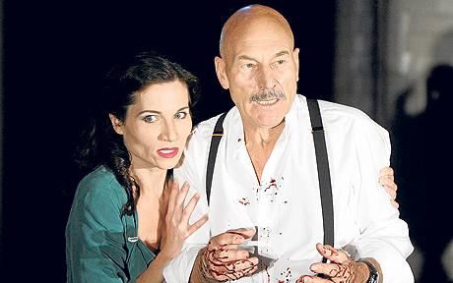
Act Two Scene Four

Slide 58
Casting Call
Old Man (the opposite of a young man)
Dr. Brewer
Ross (a servant of King Duncan)
Dr. Brown bringer of awesome beats via poetry and stuff
Major SIlveria
Macduff (pretty much the opposite of Macbeth)
Dr. Brown of the masculine variety
Dr. Jeffries

Slide 59
Enter ROSS with an OLD MAN
OLD MAN
Threescore and ten I can remember well,
Within the volume of which time I have seen
Hours dreadful and things strange, but this sore night
Hath trifled former knowings.
ROSS
Ha, good father,
Thou seest the heavens, as troubled with man’s act,
Threatens his bloody stage. By th' clock ’tis day,
And yet dark night strangles the travelling lamp.
Is ’t night’s predominance or the day’s shame
That darkness does the face of Earth entomb
When living light should kiss it?
ROSS and an OLD MAN enter.
OLD MAN
I can remember the past seventy years pretty well, and in all that time I have seen dreadful hours and strange things. But last night’s horrors make everything that came before seem like a joke.
ROSS
Ah yes, old man. You can see the skies. They look like they’re upset about what mankind has been doing, and they’re threatening the Earth with storms. The clock says it’s daytime, but dark night is strangling the sun. Is it because night is so strong, or because day is so weak, that darkness covers the earth when it’s supposed to be light?

Slide 60
OLD MAN
'Tis unnatural,
Even like the deed that’s done. On Tuesday last,
A falcon, tow'ring in her pride of place,
Was by a mousing owl hawked at and killed.
ROSS
And Duncan’s horses—a thing most strange and certain—
Beauteous and swift, the minions of their race,
Turned wild in nature, broke their stalls, flung out,
Contending 'gainst obedience, as they would
Make war with mankind.
OLD MAN
It’s unnatural, just like the murder that has been committed. Last Tuesday a falcon was circling high in the sky, and it was caught and killed by an ordinary owl that usually goes after mice.
ROSS
And something else strange happened. Duncan’s horses, which are beautiful and swift and the best of their breed, suddenly turned wild and broke out of their stalls. Refusing to be obedient as usual, they acted like they were at war with mankind.

Slide 61
OLD MAN
'Tis said they eat each other.
ROSS
They did so, to th' amazement of mine eyes
That looked upon ’t. Here comes the good Macduff.
Enter MACDUFF
ROSS
How goes the world, sir, now?
OLD MAN
They say the horses ate each other.
ROSS
I saw it with my own eyes. It was an amazing sight. Here comes the good Macduff.
MACDUFF enters.
ROSS
How are things going now?

Slide 62
MACDUFF
Why, see you not?
ROSS
Is ’t known who did this more than bloody deed?
MACDUFF
Those that Macbeth hath slain.
ROSS
Alas, the day!
What good could they pretend?
MACDUFF
Can’t you see for yourself?
ROSS
Does anyone know who committed this horrible crime?
MACDUFF
The servants Macbeth killed.
ROSS
It’s too bad he killed them. What good would it have done those men to kill Duncan?

Slide 63
MACDUFF
They were suborned.
Malcolm and Donalbain, the king’s two sons,
Are stol'n away and fled, which puts upon them
Suspicion of the deed.
ROSS
'Gainst nature still!
Thriftless ambition, that will raven up
Thine own lives' means! Then ’tis most like
The sovereignty will fall upon Macbeth.
MACDUFF
They were paid to betray their master. Malcolm and Donalbain, the king’s two sons, have run away and fled, which makes them the prime suspects.
ROSS
Everything about this is unnatural! What a stupid ambition, causing a son to kill the father who supports him. Then it looks like Macbeth will become king.

Slide 64
MACDUFF
He is already named and gone to Scone
To be invested.
ROSS
Where is Duncan’s body?
MACDUFF
Carried to Colmekill,
The sacred storehouse of his predecessors,
And guardian of their bones.
ROSS
Will you to Scone?
MACDUFF
He has already been named king and has left for Scone to be crowned.
ROSS
Where is Duncan’s body?
MACDUFF
It was carried to Colmekill to be placed in the tomb of his ancestors, where their bones are kept safe.
ROSS
Are you going to Scone?

Slide 65
MACDUFF
No, cousin, I’ll to Fife.
ROSS
Well, I will thither.
MACDUFF
Well, may you see things well done there. Adieu,
Lest our old robes sit easier than our new!
ROSS
Farewell, father.
OLD MAN
God’s benison go with you and with those
That would make good of bad and friends of foes.
Exeunt
MACDUFF
No, cousin, I’m going to Fife.
ROSS
Well, I’ll go to Scone.
MACDUFF
I hope things go well there. Good-bye! And let’s hope things don’t get worse.
ROSS
Farewell, old man.
OLD MAN
May God’s blessing go with you and with all who turn bad into good, and enemies into friends!
They all exit.

